Slide 1
Equations of Motion
Stability and Control
Dr. E. A. Adjei
Unit Three

Slide 2
Systems of Axes and Notation
Before commencing the main task of developing mathematical models of the aeroplane, it is first necessary to put in place an appropriate and secure foundation on which to build the models.
The foundation comprises a mathematical framework in which the equations of motion can be developed in an orderly and consistent way.
Since aeroplanes have six degrees of freedom, the description of their motion can be relatively complex. Therefore, motion is usually described by a number of variables that are related to a suitably chosen system of axes.

Slide 3
In the UK, the scheme of notation and nomenclature in common use is based on that developed by Hopkin 1970 and a simplified summary may be found in the appropriate ESDU 1987 data item. The notation and nomenclature in this chapter is based on Hopkin 1970.
By making the appropriate choice of axis systems, order and consistency may be introduced to the process of model building.
The importance of order and consistency in the definition of the mathematical framework cannot be overemphasized.

Slide 4
Axes Systems
There are several axes system standards; earth axes, ground, local horizon, reference body, axes and aerodynamic, wind, or stability axes.
Earth axis: The accepted convention for defining earth axis defines that, a reference point O₀ on the surface of the earth is the origin of a right-handed orthogonal system of axes ( O_{o}x_{o}y_{o} z_{o} ), where O_{o} x_{o} points to the north, O_{o} y_{o} points to the east and points vertically down along the gravity vector.
Clearly, the plane (O_{O} x_{o} y_{o}) defines the local horizontal plane which is tangential to the surface of the earth. Thus, the flight path of aeroplane flying in the atmosphere in the vicinity of reference point O_{o} may be completely described by its coordinates in the axis system. This therefore assumes a flat earth, where the vertical is tied to the gravity vector. This model is quite adequate for localized flight, although is best suited to navigation and performance applications where flight path trajectories are of primary interest.

Slide 5
For investigations involving trans-global navigation, the axis system described is inappropriate, a spherical coordinating system being preferred. Similarly, for trans-atmospheric flight involving the launch and re-entry of space vehicles, a spherical coordinates system would be more appropriate.
However, since in such an application the angular velocity of the earth becomes important it is necessary to define a fixed spatial axis system to which the spherical earth axis system may be referred.

Slide 6
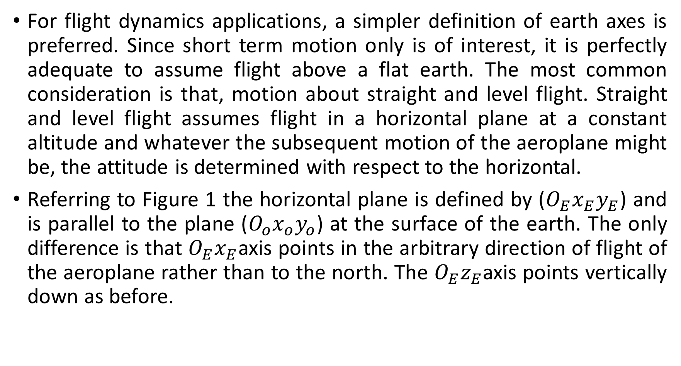
For flight dynamics applications, a simpler definition of earth axes is preferred. Since short term motion only is of interest, it is perfectly adequate to assume flight above a flat earth. The most common consideration is that, motion about straight and level flight. Straight and level flight assumes flight in a horizontal plane at a constant altitude and whatever the subsequent motion of the aeroplane might be, the attitude is determined with respect to the horizontal.
Referring to Figure 1 the horizontal plane is defined by ($O_{E}x_{E}y_{E}$) and is parallel to the plane ($O_{o}x_{o}y_{o}$) at the surface of the earth. The only difference is that $O_{E}x_{E}$axis points in the arbitrary direction of flight of the aeroplane rather than to the north. The $O_{E}z_{E}$axis points vertically down as before.

Slide 7
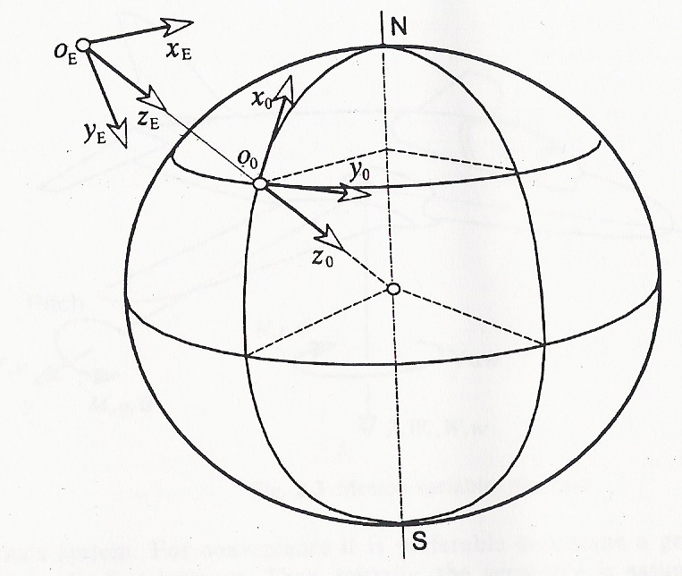
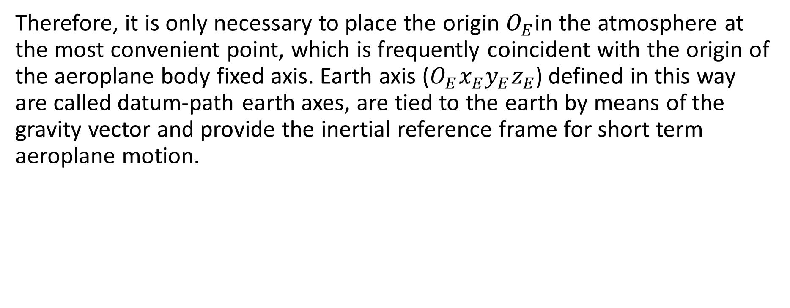
Therefore, it is only necessary to place the origin $O_{E}$in the atmosphere at the most convenient point, which is frequently coincident with the origin of the aeroplane body fixed axis. Earth axis ($O_{E}x_{E}y_{E}z_{E}$) defined in this way are called datum-path earth axes, are tied to the earth by means of the gravity vector and provide the inertial reference frame for short term aeroplane motion.
Figure 1: conventional earth axes.

Slide 8
Body Axes System
Body axes is usually define as a right-handed orthogonal axis system fixed in the aeroplane with the origin at the centre of gravity and constrained to move with the plane.
The x_{b} axis is in the airplane line of symmetry and points out the nose of the airplane. The z_{b} axis is in the plane of symmetry and points downward. The y_{b} axis is perpendicular to the x_{b} and z_{b} axis and points out the right wing as shown in Figure 2a.

Slide 9
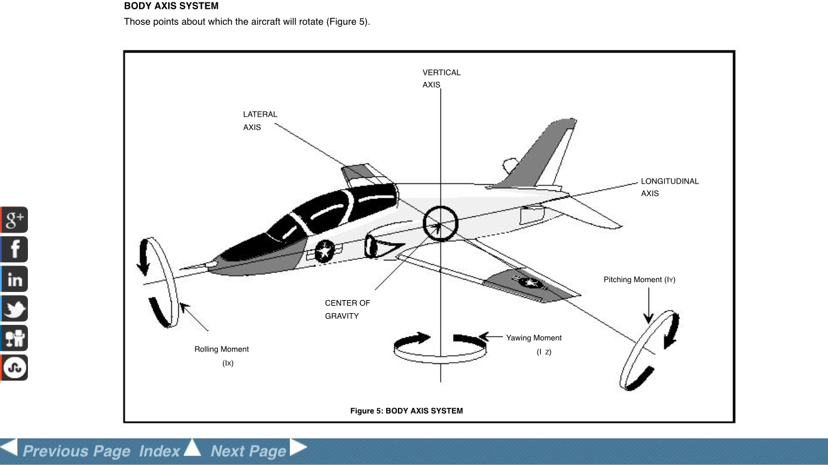
Figure 2a: Body Axes System

Slide 10
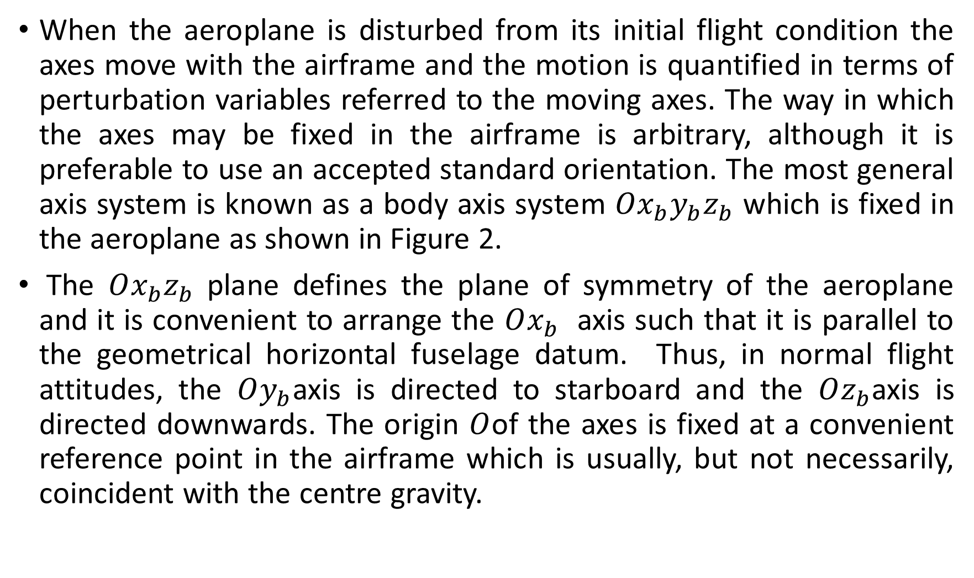
When the aeroplane is disturbed from its initial flight condition the axes move with the airframe and the motion is quantified in terms of perturbation variables referred to the moving axes. The way in which the axes may be fixed in the airframe is arbitrary, although it is preferable to use an accepted standard orientation. The most general axis system is known as a body axis system $Ox_{b}y_{b}z_{b}$ which is fixed in the aeroplane as shown in Figure 2.
The $Ox_{b}z_{b}$ plane defines the plane of symmetry of the aeroplane and it is convenient to arrange the $Ox_{b}$ axis such that it is parallel to the geometrical horizontal fuselage datum. Thus, in normal flight attitudes, the $Oy_{b}$axis is directed to starboard and the $Oz_{b}$axis is directed downwards. The origin $O$of the axes is fixed at a convenient reference point in the airframe which is usually, but not necessarily, coincident with the centre gravity.

Slide 11
Body axes tend to be used with missile and rocket configurations. It is often convenient to choose these coordinates in such a way that they are aligned with a set of reference coordinates defining the aircraft geometry: z is perpendicular to the fuselage reference plane and y to the symmetry plane.
Sometimes we choose the body axes to be aligned with the vehicle principle axes. The origin is generally taken at the aeroplane center of gravity or at a fixed reference location relative to the geometry.

Slide 12
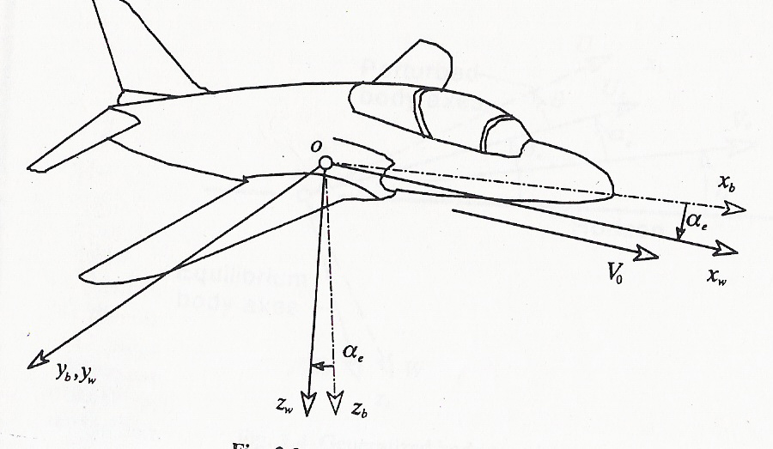
Figure 2b: Moving axes systems

Slide 13
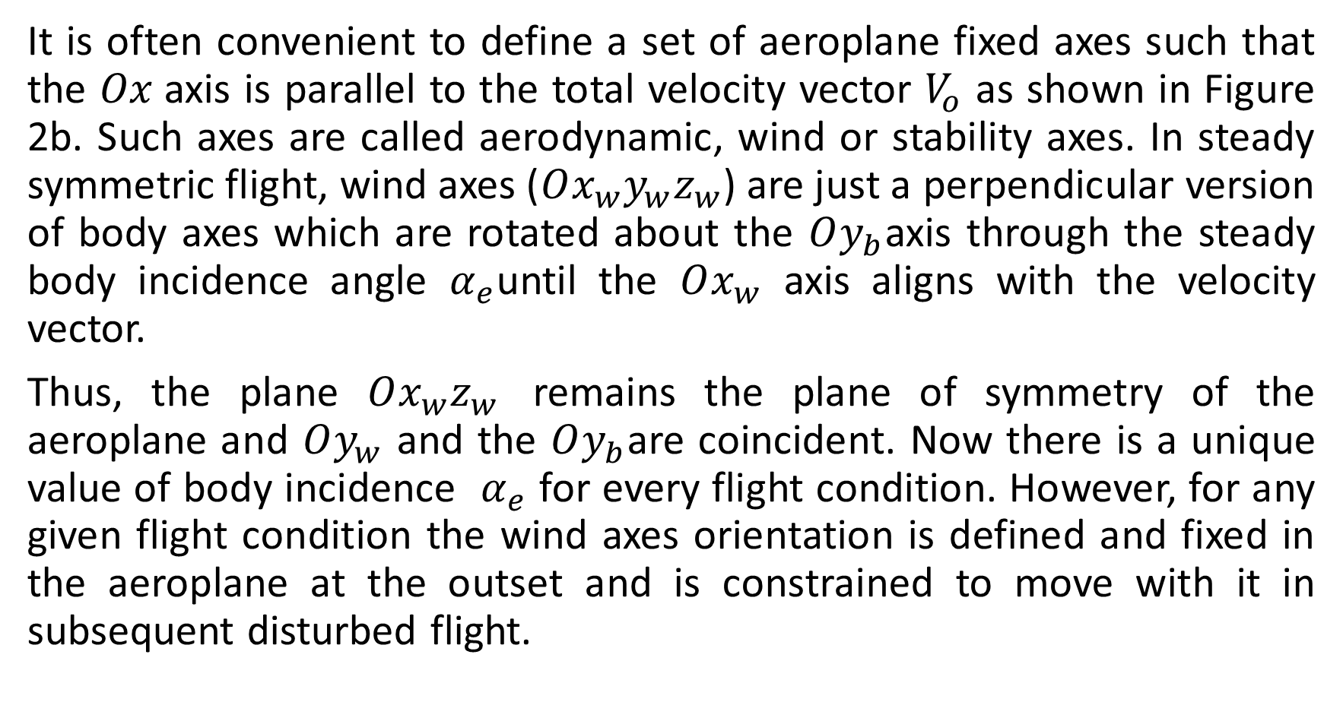
Stability, wind and aerodynamic Axes
It is often convenient to define a set of aeroplane fixed axes such that the $Ox$axis is parallel to the total velocity vector $V_{o}$ as shown in Figure 2b. Such axes are called aerodynamic, wind or stability axes. In steady symmetric flight, wind axes ($Ox_{w}y_{w}z_{w}$) are just a perpendicular version of body axes which are rotated about the $Oy_{b}$axis through the steady body incidence angle $α_{e}$until the $Ox_{w}$ axis aligns with the velocity vector.
Thus, the plane $Ox_{w}z_{w}$ remains the plane of symmetry of the aeroplane and $Oy_{w}$ and the $Oy_{b}$are coincident. Now there is a unique value of body incidence $α_{e}$ for every flight condition. However, for any given flight condition the wind axes orientation is defined and fixed in the aeroplane at the outset and is constrained to move with it in subsequent disturbed flight.

Slide 14
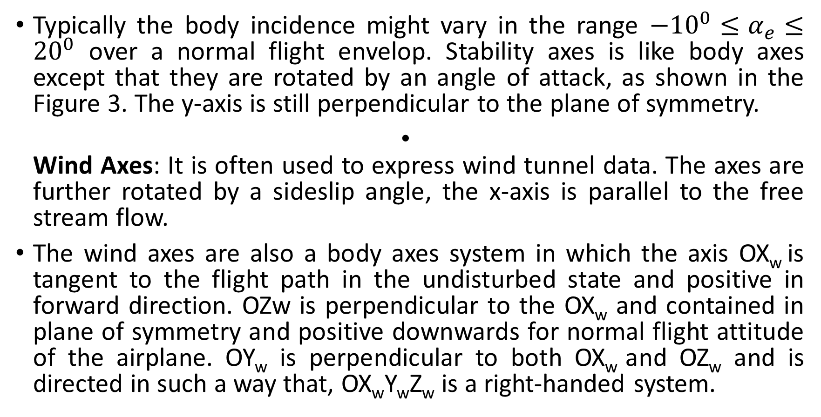
Typically the body incidence might vary in the range $−10^{0}≤α_{e}≤20^{0}$ over a normal flight envelop. Stability axes is like body axes except that they are rotated by an angle of attack, as shown in the Figure 3. The y-axis is still perpendicular to the plane of symmetry.
Wind Axes: It is often used to express wind tunnel data. The axes are further rotated by a sideslip angle, the x-axis is parallel to the free stream flow.
The wind axes are also a body axes system in which the axis OX_{w} is tangent to the flight path in the undisturbed state and positive in forward direction. OZw is perpendicular to the OX_{w} and contained in plane of symmetry and positive downwards for normal flight attitude of the airplane. OY_{w} is perpendicular to both OX_{w} and OZ_{w} and is directed in such a way that, OX_{w}Y_{w}Z_{w} is a right-handed system.

Slide 15
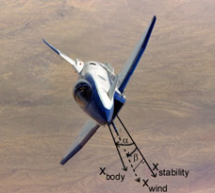
Figure 3: aircraft axes notation

Slide 16
Choice of Axes
The obvious question is when is appropriate to use wind or body axes? The choice of axes depends on the use of equations of motion. The best choice of axes simply facilitates the analysis of the equations of motion. When starting from first principles it is preferable to use generalized body axes since the resulting equations can cater for most applications. It is reasonable straightforward to simplify the equations to wind axis form if the application warrants it. On the other hand, to extend wind axis based equations to carter for the more general case is not as easy.
When dealing with numerical data for an existing aeroplane, it is not always obvious which axis has been used in the derivation of the model. When it is necessary to make experimental measurements in an actual aeroplane, or in a model, which are to be used subsequently in the equations of motion, it is preferable to use a generalized body axis system

Slide 17
Since the measuring equipment is installed in the aeroplane its location precisely known in terms of body axis coordinates which, therefore, determines the best choice of axis system. In a similar way, most aerodynamic measurements and computations are referenced to the free stream velocity vector.
For example, in wind tunnel work the obvious reference is the tunnel axis, which is coincident with the velocity vector. Thus, for aerodynamic investigations involving the equations of motion, a wind axis reference is to be preferred. Traditionally, all aerodynamic data for use in the equations of motion are referred to wind axes.
In summary, it is not particularly important which axis system is chosen provided it models the flight condition too be investigated; the end result does not depend on the choice of axis system. However, when compiling data for use in the equations of motion of an aeroplane it is quite common for some data to be referred to wind axes and for some data to be referred body axes. It therefore becomes necessary to have available the mathematical tools for transforming data between different reference axes.

Slide 18
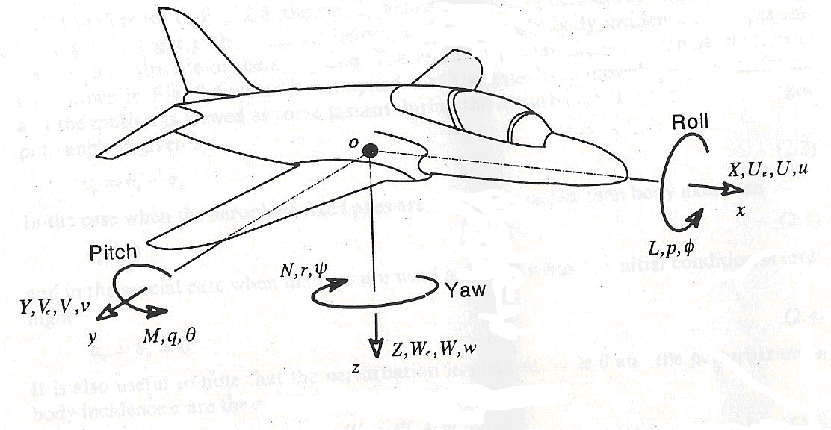
Basic notation
Before describing the equations of motion that we will solve to determine vehicle response, we establish some conventions and notation that will be used in these notes. There exist a number of different ways of expressing vehicle position, velocity, orientation, and the forces and moments that act on the vehicle. The conventions adopted will be discussed.
Figure 4

Slide 19
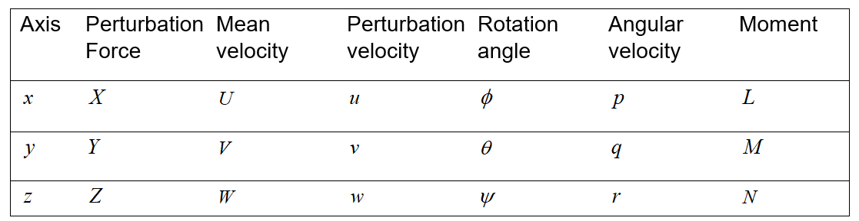
In summary, the nomenclature associated with rotational and translational motion is as follows:

Slide 20
The equations of motion
The first formal derivation of the equations of motion of motion for a rigid symmetric aeroplane is usually attributed to Bryan 1911. His treatment, with very few changes, remains in use today and provides the basis for the following development. The object is to realize Newton’s second law of motion for each of the six degrees of freedom which simply states that,
Mass X acceleration = disturbing force. 1
For the rotary degrees of freedom, the mass and acceleration becomes moment of inertia and angular acceleration respectively, whilst the disturbing force becomes the disturbing moment or torque.

Slide 21
Thus, the derivation of equations of motion requires that equation 1 be expressed in terms of the motion variables. The derivation is classical in the sense that the equations of motion are differential equations which are derived from first principles.
However, a number of equally valid alternative means for deriving the equations of motion are frequently used, for example vector methods. The classical approach is retained here since, in the author’s opinion, maximum physical visibility is maintained throughout.

Slide 22
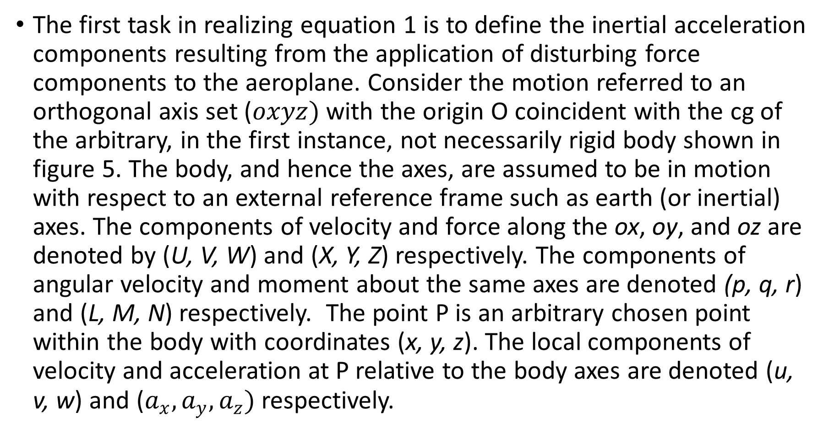
The components of inertial acceleration
The first task in realizing equation 1 is to define the inertial acceleration components resulting from the application of disturbing force components to the aeroplane. Consider the motion referred to an orthogonal axis set ($oxyz)$ with the origin O coincident with the cg of the arbitrary, in the first instance, not necessarily rigid body shown in figure 5. The body, and hence the axes, are assumed to be in motion with respect to an external reference frame such as earth (or inertial) axes. The components of velocity and force along the ox, oy, and oz are denoted by (U, V, W) and (X, Y, Z) respectively. The components of angular velocity and moment about the same axes are denoted (p, q, r) and (L, M, N) respectively. The point P is an arbitrary chosen point within the body with coordinates (x, y, z). The local components of velocity and acceleration at P relative to the body axes are denoted (u, v, w) and ($a_{x},a_{y},a_{z})$ respectively.

Slide 23
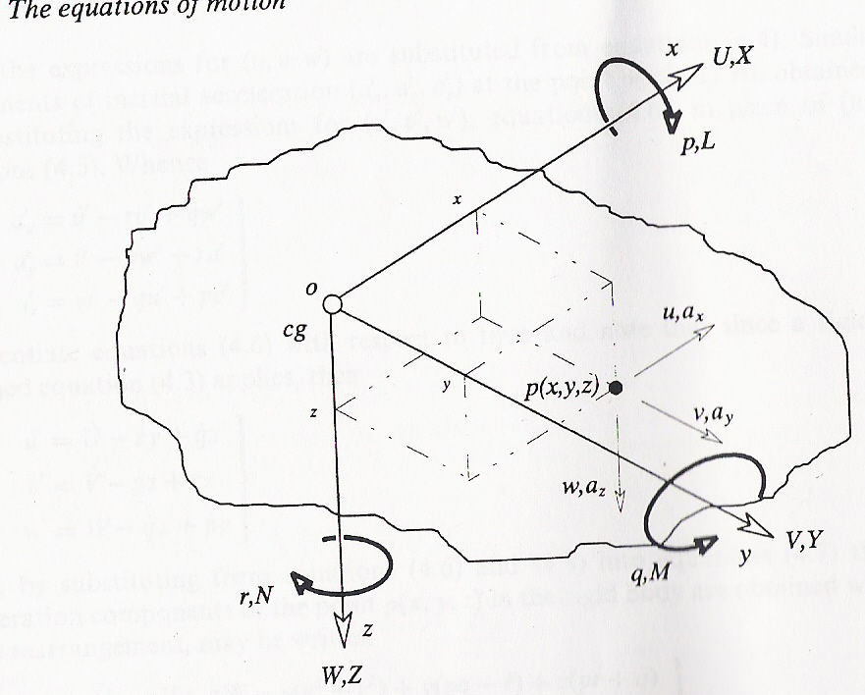
Figure 5:

Slide 24
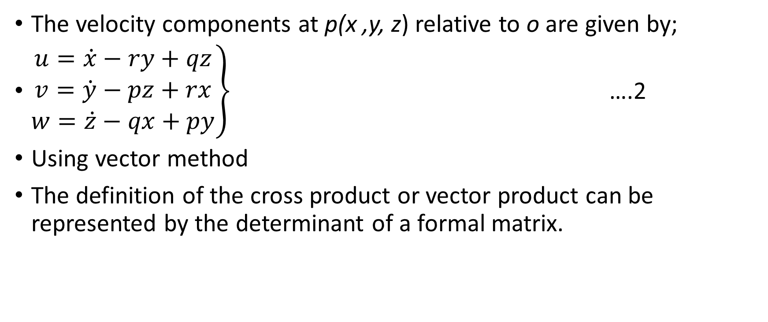
The velocity components at p(x ,y, z) relative to o are given by;
$\left.\begin{aligned}u=\dot{x}−ry+qz \\ v=\dot{y}−pz+rx \\ w=\dot{z}−qx+py\end{aligned}\right\}$ ….2
Using vector method
The definition of the cross product or vector product can be represented by the determinant of a formal matrix.

Slide 25
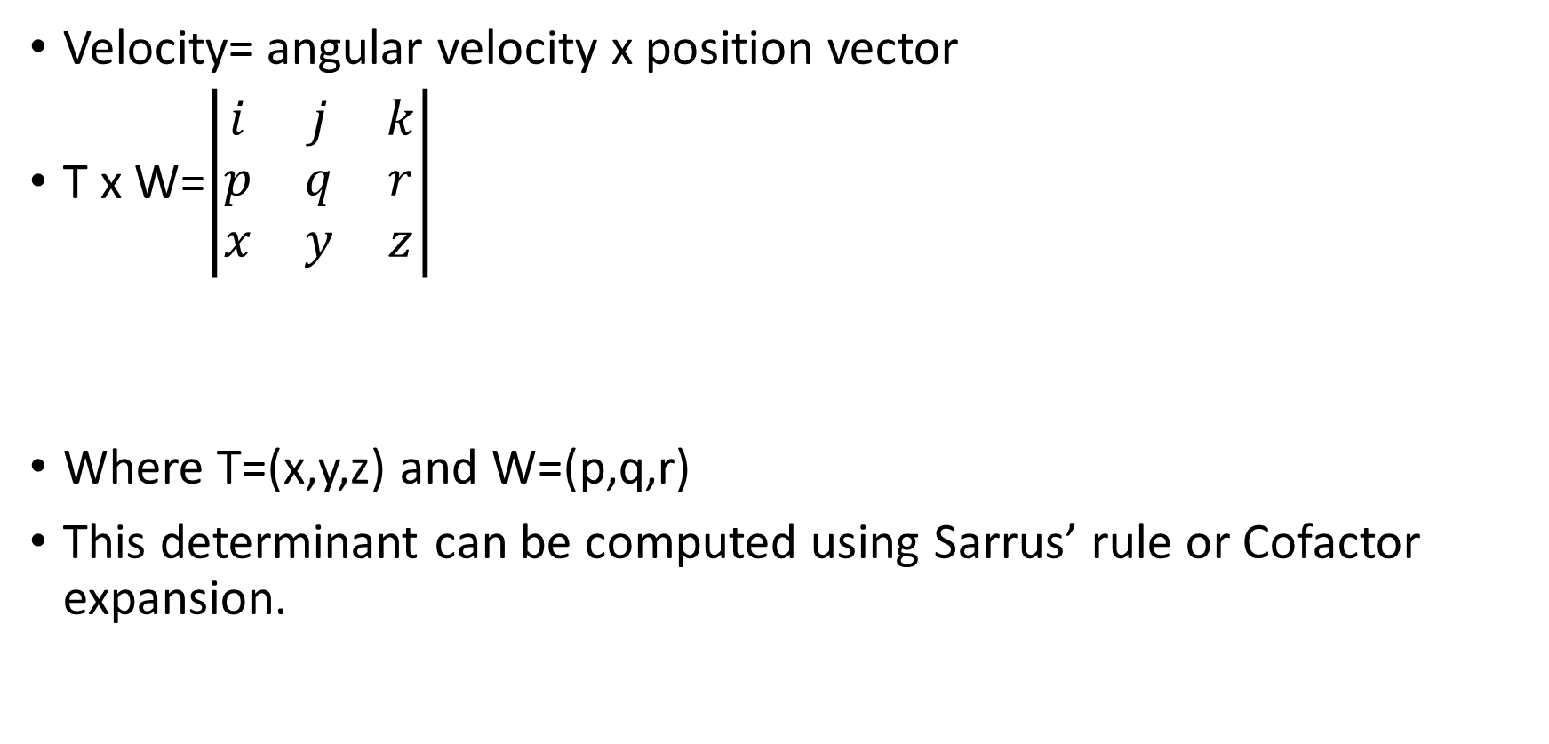
Velocity= angular velocity x position vector
T x W=$\left|\begin{matrix}i & j & k \\ p & q & r \\ x & y & z\end{matrix}\right|$
Where T=(x,y,z) and W=(p,q,r)
This determinant can be computed using Sarrus’ rule or Cofactor expansion.

Slide 26
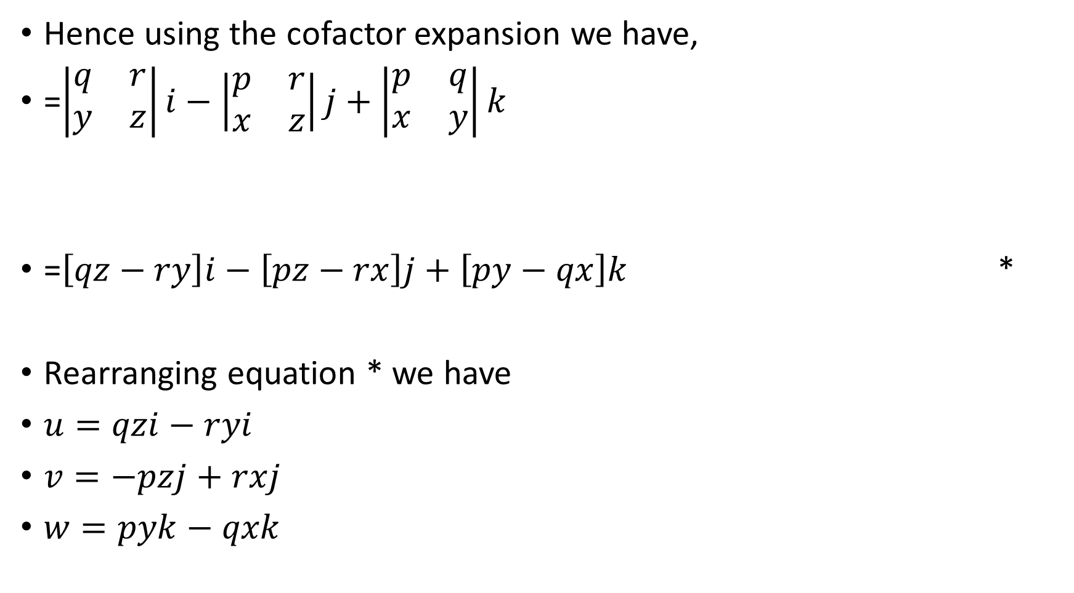
Hence using the cofactor expansion we have,
=$\left|\begin{matrix}q & r \\ y & z\end{matrix}\right|i−\left|\begin{matrix}p & r \\ x & z\end{matrix}\right|j+\left|\begin{matrix}p & q \\ x & y\end{matrix}\right|k$
=$\left[qz−ry\right]i−\left[pz−rx\right]j+\left[py−qx\right]k$ *
Rearranging equation * we have
$u=qzi−ryi$
$v=−pzj+rxj$
$w=pyk−qxk$

Slide 27
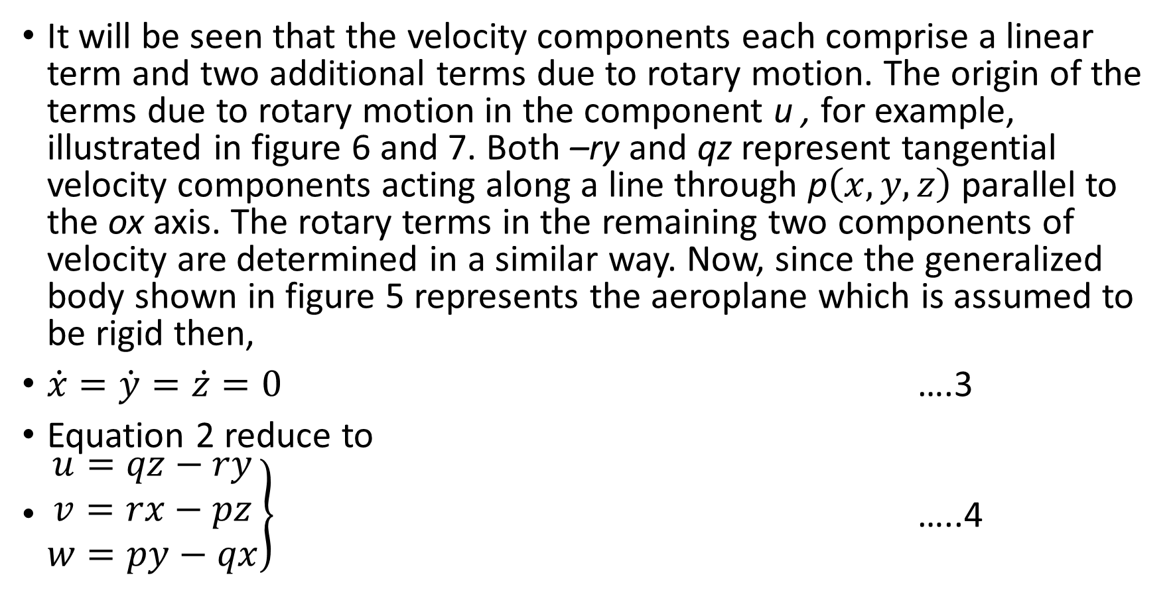
It will be seen that the velocity components each comprise a linear term and two additional terms due to rotary motion. The origin of the terms due to rotary motion in the component u , for example, illustrated in figure 6 and 7. Both –ry and qz represent tangential velocity components acting along a line through p$\left(x,y,z\right)$ parallel to the ox axis. The rotary terms in the remaining two components of velocity are determined in a similar way. Now, since the generalized body shown in figure 5 represents the aeroplane which is assumed to be rigid then,
$\dot{x}=\dot{y}=\dot{z}=0$ ….3
Equation 2 reduce to
$\left.\begin{aligned}u=qz−ry \\ v=rx−pz \\ w=py−qx\end{aligned}\right\}$ …..4

Slide 28
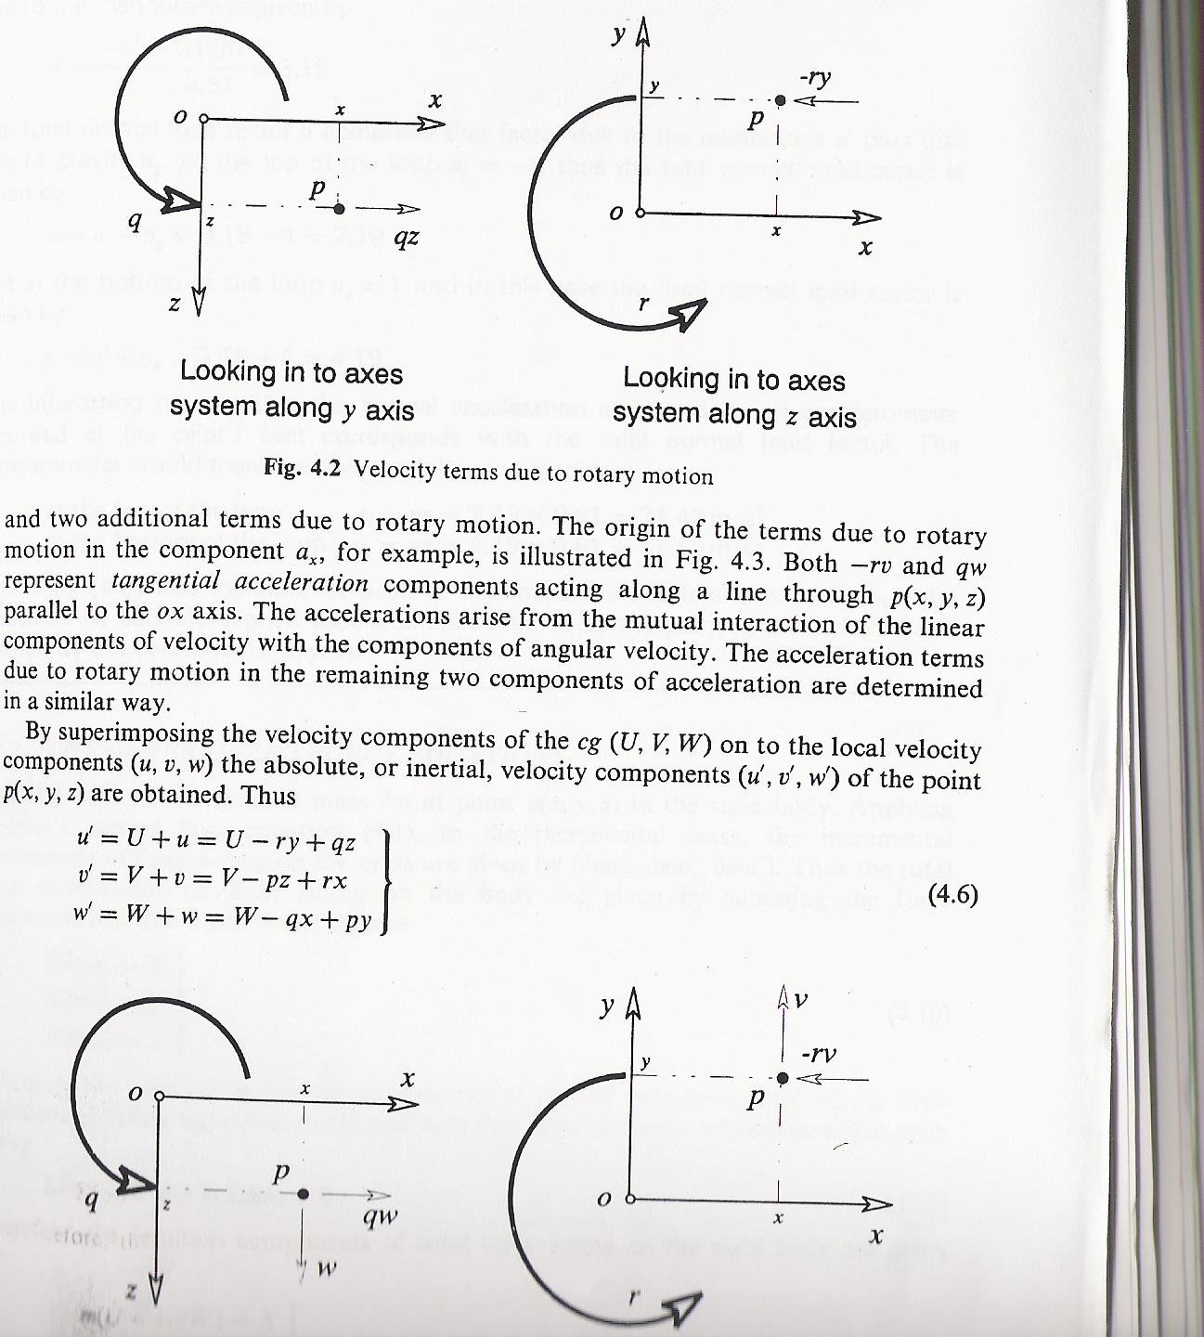
Figure 6: velocity terms due to rotary motion

Slide 29
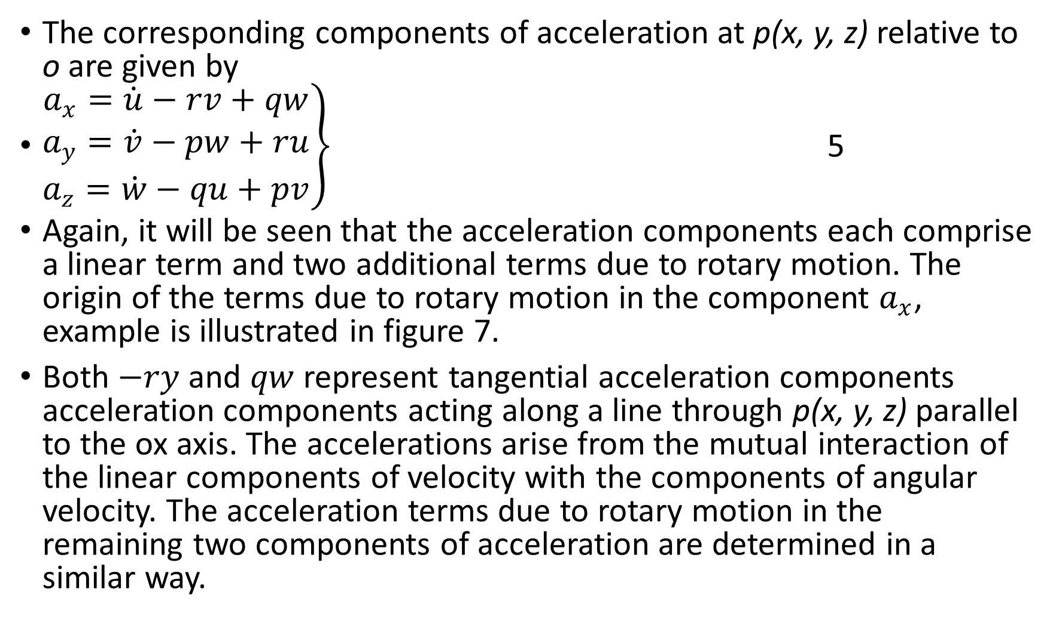
The corresponding components of acceleration at p(x, y, z) relative to o are given by
$\left.\begin{aligned}a_{x}=\dot{u}−rv+qw \\ a_{y}=\dot{v}−pw+ru \\ a_{z}=\dot{w}−qu+pv\end{aligned}\right\}$ 5
Again, it will be seen that the acceleration components each comprise a linear term and two additional terms due to rotary motion. The origin of the terms due to rotary motion in the component $a_{x}$, example is illustrated in figure 7.
Both $−ry$ and $qw$ represent tangential acceleration components acceleration components acting along a line through p(x, y, z) parallel to the ox axis. The accelerations arise from the mutual interaction of the linear components of velocity with the components of angular velocity. The acceleration terms due to rotary motion in the remaining two components of acceleration are determined in a similar way.

Slide 30
Figure 7: Acceleration terms due to rotary motion.
Looking in to axes looking in to axes
System along y-axis system along z-axis

Slide 31
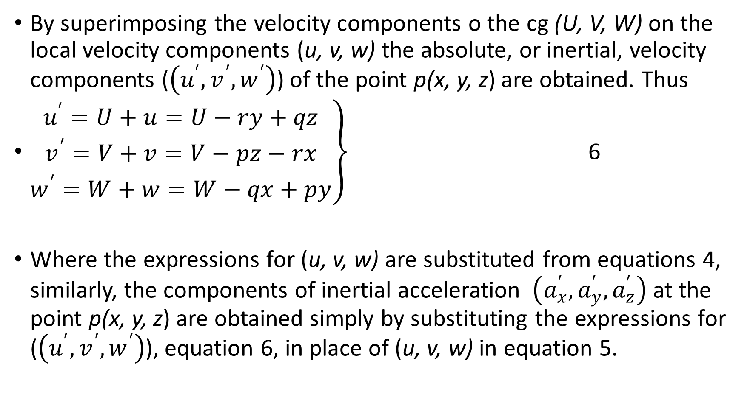
By superimposing the velocity components o the cg (U, V, W) on the local velocity components (u, v, w) the absolute, or inertial, velocity components ($\left(u^{′},v^{′},w^{′}\right)$) of the point p(x, y, z) are obtained. Thus
$\left.\begin{aligned}u^{′}=U+u=U−ry+qz \\ v^{′}=V+v=V−pz−rx \\ w^{′}=W+w=W−qx+py\end{aligned}\right\}$ 6
Where the expressions for (u, v, w) are substituted from equations 4, similarly, the components of inertial acceleration $\left(a_{x}^{′},a_{y}^{′},a_{z}^{′}\right)$ at the point p(x, y, z) are obtained simply by substituting the expressions for ($\left(u^{′},v^{′},w^{′}\right)$), equation 6, in place of (u, v, w) in equation 5.

Slide 32
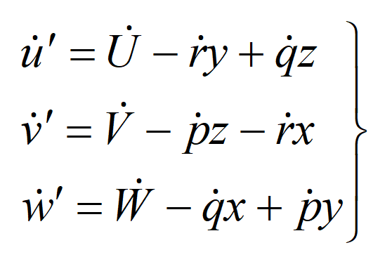
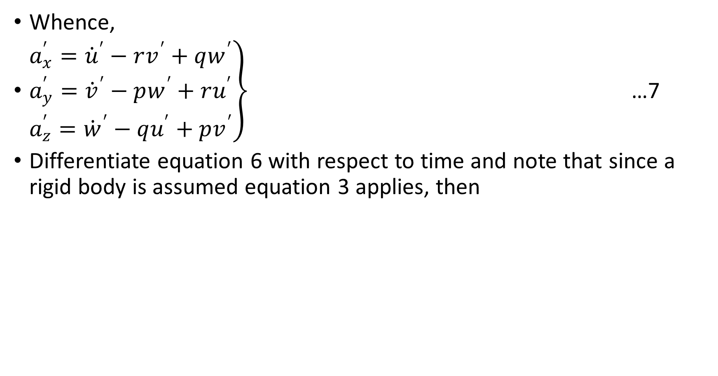
Whence,
$\left.\begin{aligned}a_{x}^{′}={\dot{u}}^{′}−rv^{′}+qw^{′} \\ a_{y}^{′}={\dot{v}}^{′}−pw^{′}+ru^{′} \\ a_{z}^{′}={\dot{w}}^{′}−qu^{′}+pv^{′}\end{aligned}\right\}$ …7
Differentiate equation 6 with respect to time and note that since a rigid body is assumed equation 3 applies, then

Slide 33
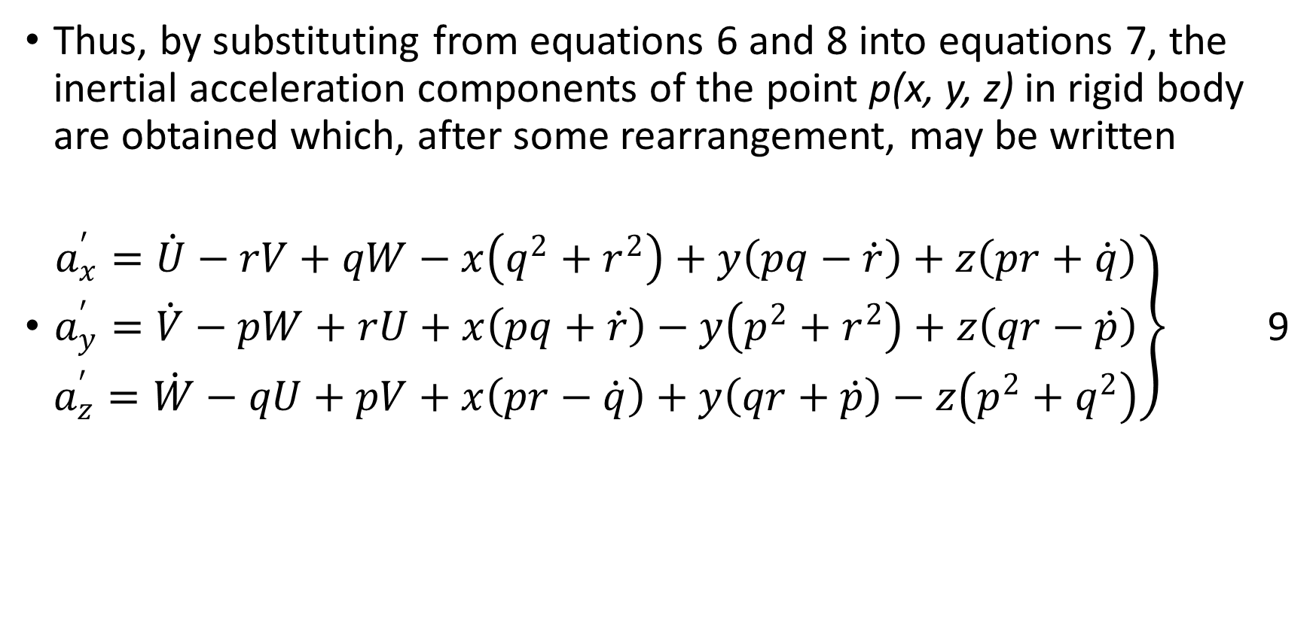
Thus, by substituting from equations 6 and 8 into equations 7, the inertial acceleration components of the point p(x, y, z) in rigid body are obtained which, after some rearrangement, may be written
$\left.\begin{aligned}a_{x}^{′}=\dot{U}−rV+qW−x\left(q^{2}+r^{2}\right)+y\left(pq−\dot{r}\right)+z\left(pr+\dot{q}\right) \\ a_{y}^{′}=\dot{V}−pW+rU+x\left(pq+\dot{r}\right)−y\left(p^{2}+r^{2}\right)+z\left(qr−\dot{p}\right) \\ a_{z}^{′}=\dot{W}−qU+pV+x\left(pr−\dot{q}\right)+y\left(qr+\dot{p}\right)−z\left(p^{2}+q^{2}\right)\end{aligned}\right\}$ 9

Slide 34
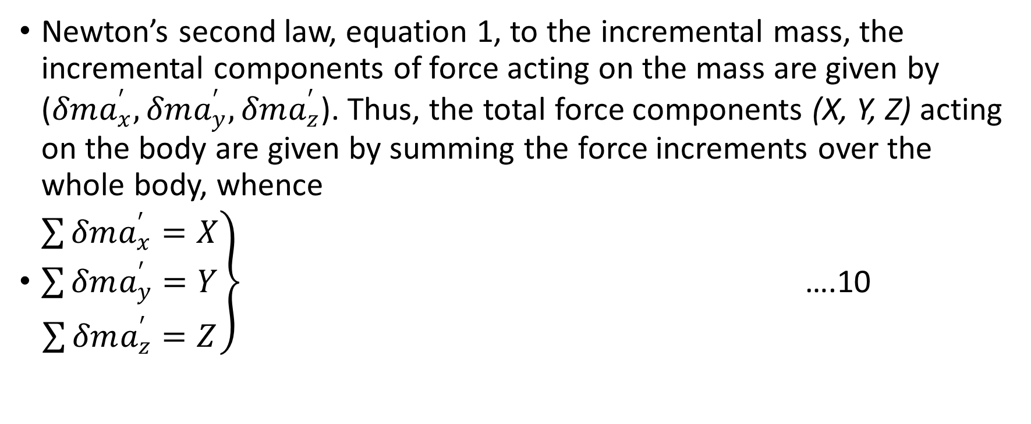
Generalized Force Equation
Newton’s second law, equation 1, to the incremental mass, the incremental components of force acting on the mass are given by ($δma_{x}^{′},δma_{y}^{′},δma_{z}^{′}$). Thus, the total force components (X, Y, Z) acting on the body are given by summing the force increments over the whole body, whence
$\left.\begin{aligned}\sum{δma_{x}^{′}=X} \\ \sum{δma_{y}^{′}}=Y \\ \sum{δma_{z}^{′}=Z}\end{aligned}\right\}$ ….10

Slide 35
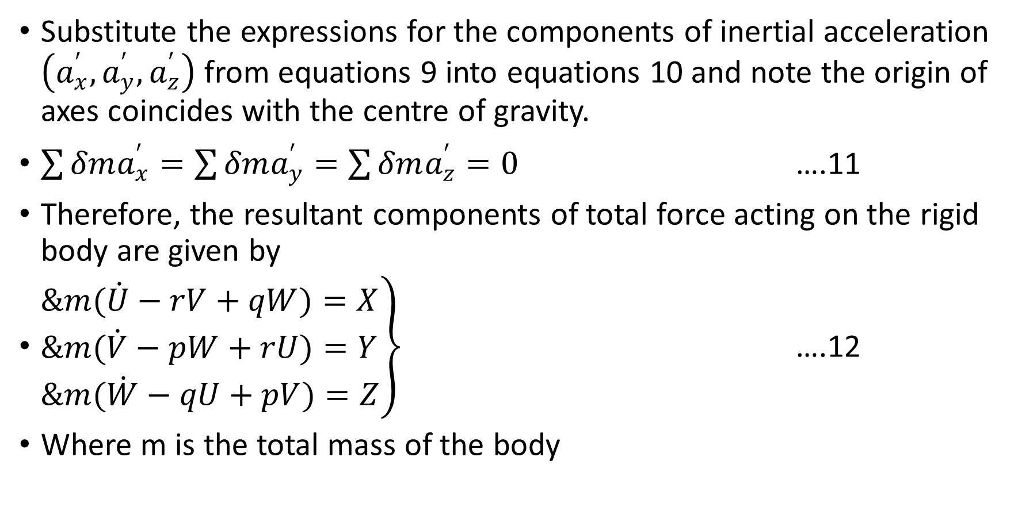
Substitute the expressions for the components of inertial acceleration $\left(a_{x}^{′},a_{y}^{′},a_{z}^{′}\right)$ from equations 9 into equations 10 and note the origin of axes coincides with the centre of gravity.
$\sum{δma_{x}^{′}=\sum{δma_{y}^{′}=\sum{δma_{z}^{′}=0}}}$ ….11
Therefore, the resultant components of total force acting on the rigid body are given by
$\left.\begin{aligned}&m(\dot{U}−rV+qW)=X \\ &m(\dot{V}−pW+rU)=Y \\ &m(\dot{W}−qU+pV)=Z\end{aligned}\right\}$ ….12
Where m is the total mass of the body

Slide 36
Equations 12 represents the force equations of a generalized rigid body and describe the motion of its cg since the origin of the axis system is co-located with the cg in the body.
In some applications, for example the airship, it is often convenient to locate the origin of axis system at some point other than the cg. In such cases the condition described by equation 11 does not apply and equations 12 would include rather more terms.

Slide 37
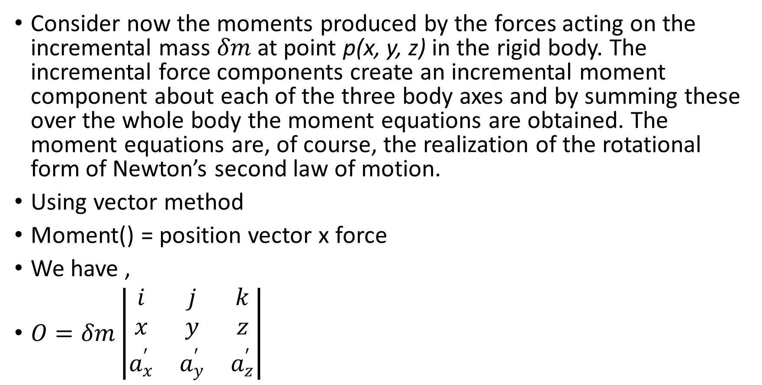
Generalized Moment Equations
Consider now the moments produced by the forces acting on the incremental mass $δm$at point p(x, y, z) in the rigid body. The incremental force components create an incremental moment component about each of the three body axes and by summing these over the whole body the moment equations are obtained. The moment equations are, of course, the realization of the rotational form of Newton’s second law of motion.
Using vector method
Moment() = position vector x force
We have ,
$O=δm\left|\begin{matrix}i & j & k \\ x & y & z \\ a_{x}^{′} & a_{y}^{′} & a_{z}^{′}\end{matrix}\right|$

Slide 38
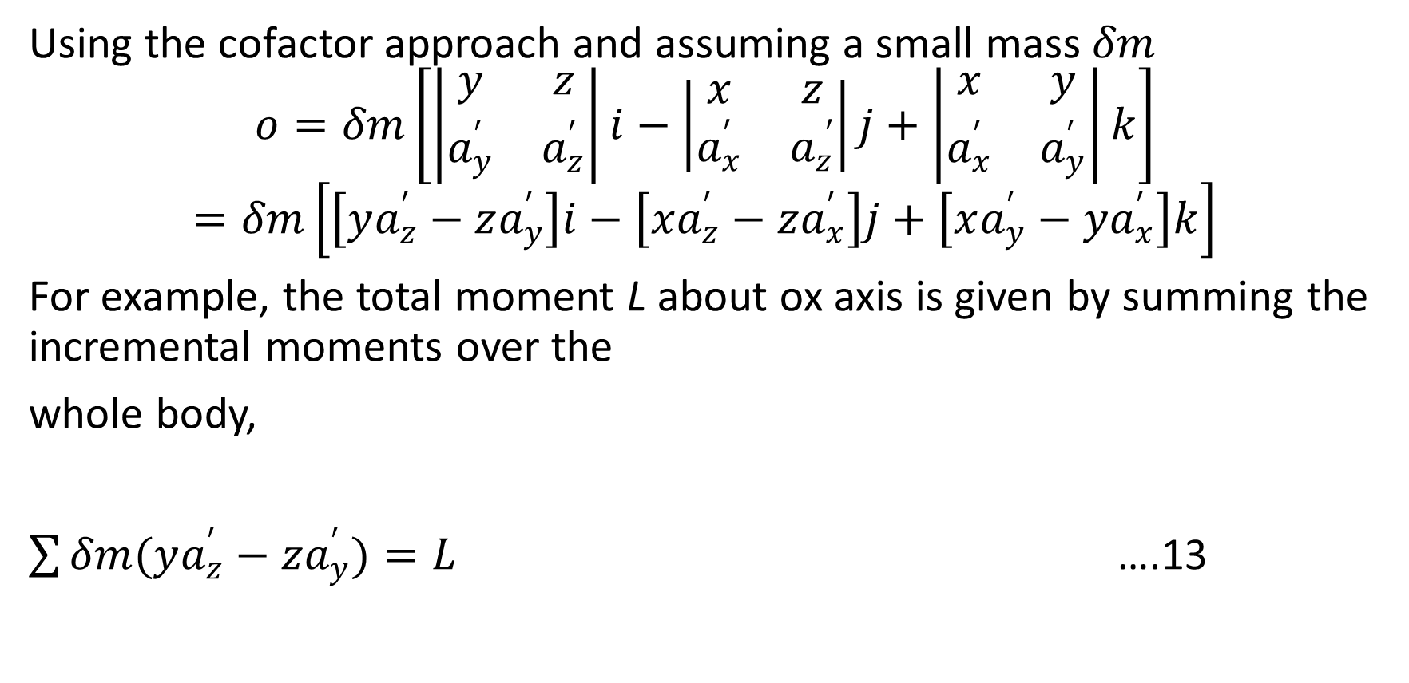
Using the cofactor approach and assuming a small mass $δm$
$$o=δm\left[\left|\begin{matrix}y & z \\ a_{y}^{′} & a_{z}^{′}\end{matrix}\right|i−\left|\begin{matrix}x & z \\ a_{x}^{′} & a_{z}^{ ′}\end{matrix}\right|j+\left|\begin{matrix}x & y \\ a_{x}^{′} & a_{y}^{′}\end{matrix}\right|k\right]$$
$$=δm\left[\left[ya_{z}^{′}−za_{y}^{′}\right]i−\left[xa_{z}^{′}−za_{x}^{′}\right]j+\left[xa_{y}^{′}−ya_{x}^{′}\right]k\right]$$
For example, the total moment L about ox axis is given by summing the incremental moments over the
whole body,
$\sum{δm(ya_{z}^{′}−za_{y}^{′})=L}$ ….13

Slide 39
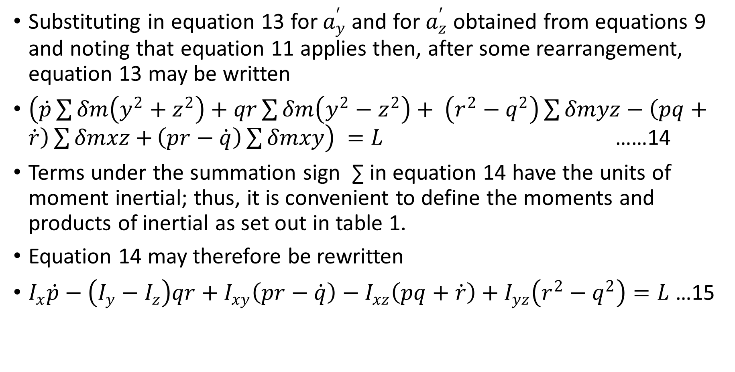
Substituting in equation 13 for $a_{y}^{′}$and for $a_{z}^{′}$ obtained from equations 9 and noting that equation 11 applies then, after some rearrangement, equation 13 may be written
$\left(\dot{p}\sum{δm\left(y^{2}+z^{2}\right)+qr\sum{δm\left(y^{2}−z^{2}\right)+ \left(r^{2}−q^{2}\right)\sum{δmyz−\left(pq+\dot{r}\right)\sum{δmxz+}\left(pr−\dot{q}\right)\sum{δmxy}}}}\right) =L$ ……14
Terms under the summation sign ∑ in equation 14 have the units of moment inertial; thus, it is convenient to define the moments and products of inertial as set out in table 1.
Equation 14 may therefore be rewritten
$I_{x}\dot{p}−\left(I_{y}−I_{z}\right)qr+I_{xy}\left(pr−\dot{q}\right)−I_{xz}\left(pq+\dot{r}\right)+I_{yz}\left(r^{2}−q^{2}\right)=L$ …15

Slide 40
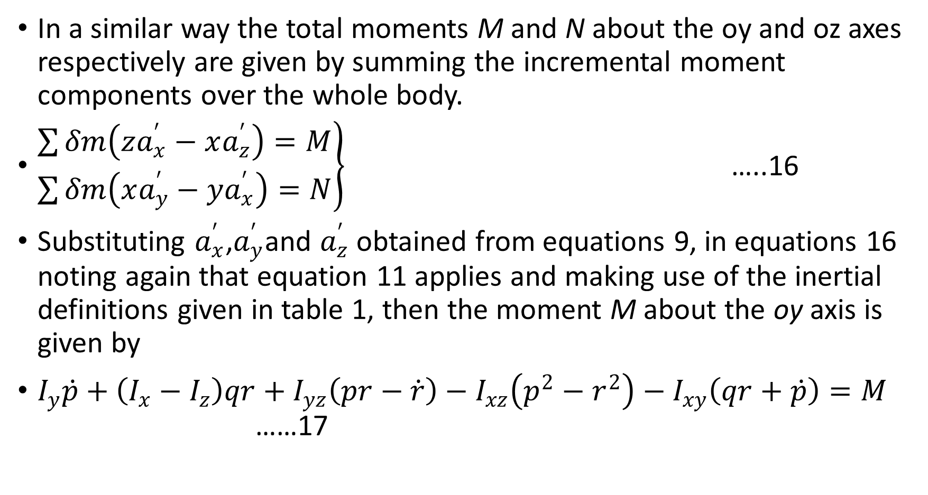
In a similar way the total moments M and N about the oy and oz axes respectively are given by summing the incremental moment components over the whole body.
$\left.\begin{aligned}\sum{δm\left(za_{x}^{′}−xa_{z}^{′}\right)=M} \\ \sum{δm\left(xa_{y}^{′}−ya_{x}^{′}\right)}=N\end{aligned}\right\}$ …..16
Substituting $a_{x}^{′}$,$a_{y}^{′}$and $a_{z}^{′}$ obtained from equations 9, in equations 16 noting again that equation 11 applies and making use of the inertial definitions given in table 1, then the moment M about the oy axis is given by
$I_{y}\dot{p}+\left(I_{x}−I_{z}\right)qr+I_{yz}\left(pr−\dot{r}\right)−I_{xz}\left(p^{2}−r^{2}\right)−I_{xy}\left(qr+\dot{p}\right)=M$ ……17

Slide 41
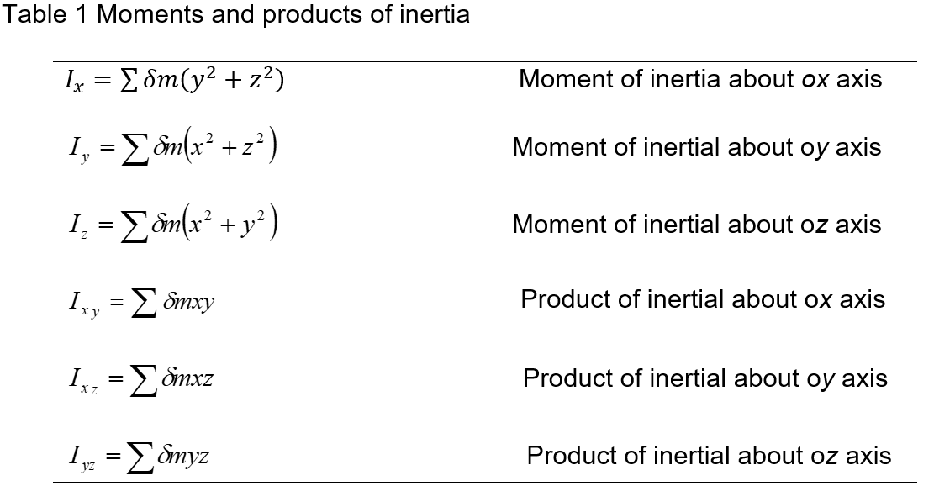
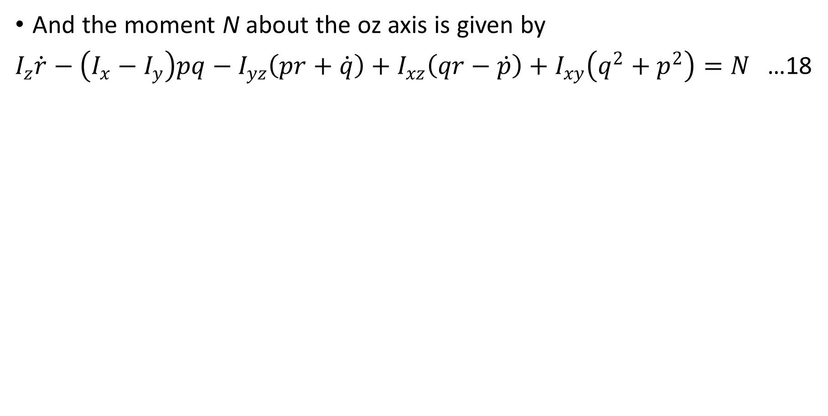
And the moment N about the oz axis is given by
$I_{z}\dot{r}−\left(I_{x}−I_{y}\right)pq−I_{yz}\left(pr+\dot{q}\right)+I_{xz}\left(qr−\dot{p}\right)+I_{xy}\left(q^{2}+p^{2}\right)=N$ …18

Slide 42
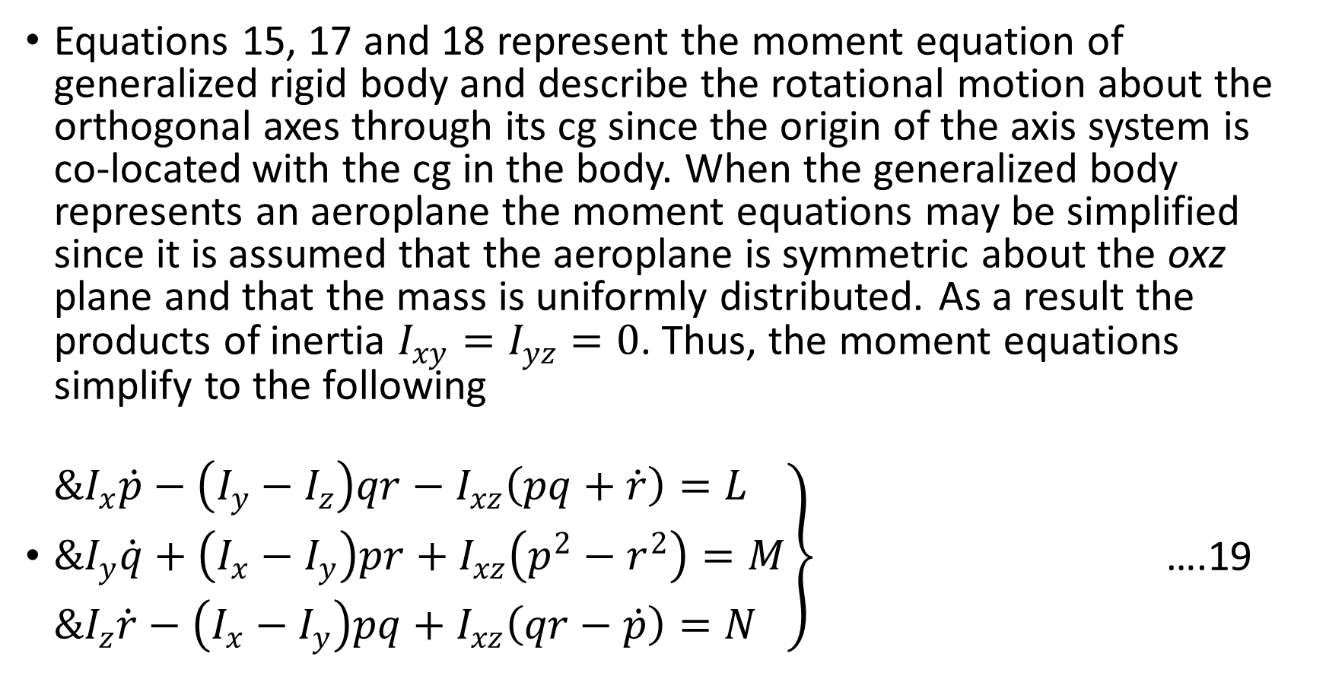
Equations 15, 17 and 18 represent the moment equation of generalized rigid body and describe the rotational motion about the orthogonal axes through its cg since the origin of the axis system is co-located with the cg in the body. When the generalized body represents an aeroplane the moment equations may be simplified since it is assumed that the aeroplane is symmetric about the oxz plane and that the mass is uniformly distributed. As a result the products of inertia $I_{xy}=I_{yz}=0$. Thus, the moment equations simplify to the following
$\left.\begin{aligned}&I_{x}\dot{p}−\left(I_{y}−I_{z}\right)qr−I_{xz}\left(pq+\dot{r}\right)=L \\ &I_{y}\dot{q}+\left(I_{x}−I_{y}\right)pr+I_{xz}\left(p^{2}−r^{2}\right)=M \\ &I_{z}\dot{r}−\left(I_{x}−I_{y}\right)pq+I_{xz}\left(qr−\dot{p}\right)=N\end{aligned}\right\}$ ….19

Slide 43
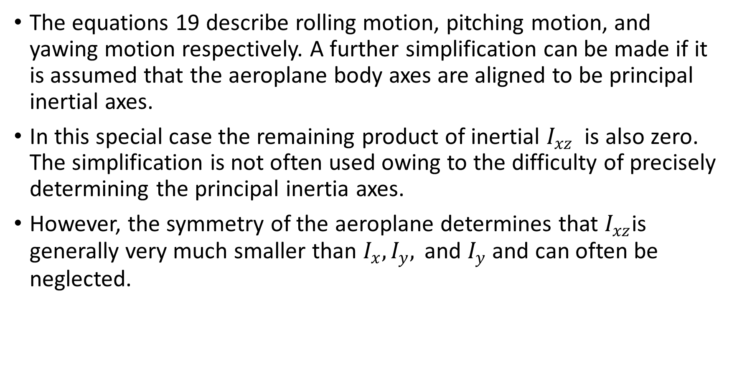
The equations 19 describe rolling motion, pitching motion, and yawing motion respectively. A further simplification can be made if it is assumed that the aeroplane body axes are aligned to be principal inertial axes.
In this special case the remaining product of inertial $I_{xz}$ is also zero. The simplification is not often used owing to the difficulty of precisely determining the principal inertia axes.
However, the symmetry of the aeroplane determines that $I_{xz}$is generally very much smaller than $I_{x},I_{y}, \text{and} I_{y}$ and can often be neglected.

Slide 44
Disturbance Forces and Moments
Equations 12 and 19 comprise the generalized six degrees of freedom equations of motion of a rigid symmetric airframe having a uniform mass distribution. Further development of the equations adequately describes the disturbing forces and moments.
The traditional approach, after Bryan 1911, is to assume that the disturbing forces and moments are due to aerodynamic effects, gravitational effects, movement of aerodynamic controls, power effects of atmospheric disturbances. Thus, bringing together equations 12 and 19 they may be written to include these contributions as follows,

Slide 45
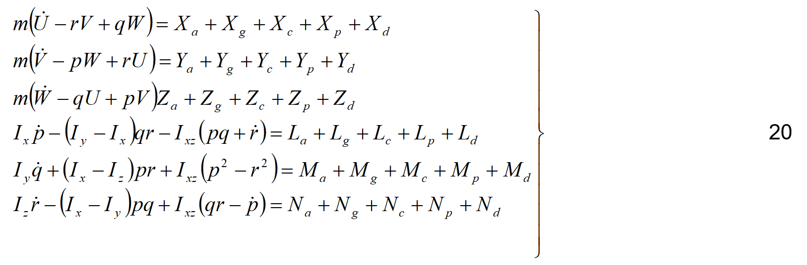

Slide 46
Now equations 20 describe the generalized motion of the aeroplane without regard for the magnitude of the motion and subject to the assumptions applying. The equations are non-linear and their solution by analytical means is not generally practicable.
Further, the terms on the right-hand side of the equations must be replaced with suitable expressions, which are particularly difficult to determine for the most general motion.
Typically, the continued development of the non-linear equations of motion and their solution is most easily accomplished using computer Modelling or simulation techniques, which are beyond the scope of this course.

Slide 47
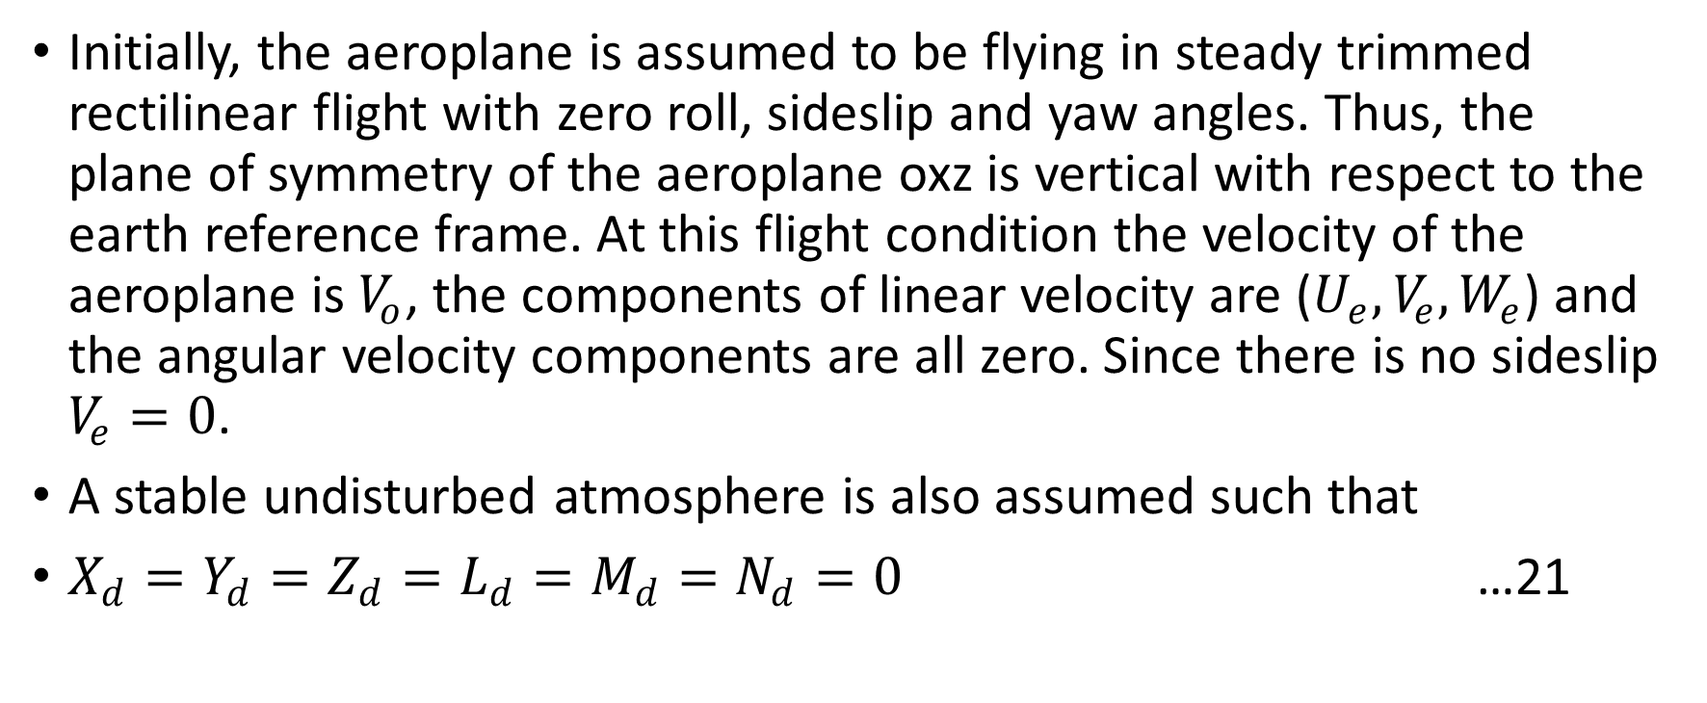
Linearized equations of motion
Initially, the aeroplane is assumed to be flying in steady trimmed rectilinear flight with zero roll, sideslip and yaw angles. Thus, the plane of symmetry of the aeroplane oxz is vertical with respect to the earth reference frame. At this flight condition the velocity of the aeroplane is $V_{o}$, the components of linear velocity are ($U_{e},V_{e},W_{e}$) and the angular velocity components are all zero. Since there is no sideslip $V_{e}=0$.
A stable undisturbed atmosphere is also assumed such that
$X_{d}=Y_{d}=Z_{d}=L_{d}=M_{d}=N_{d}=0$ …21

Slide 48
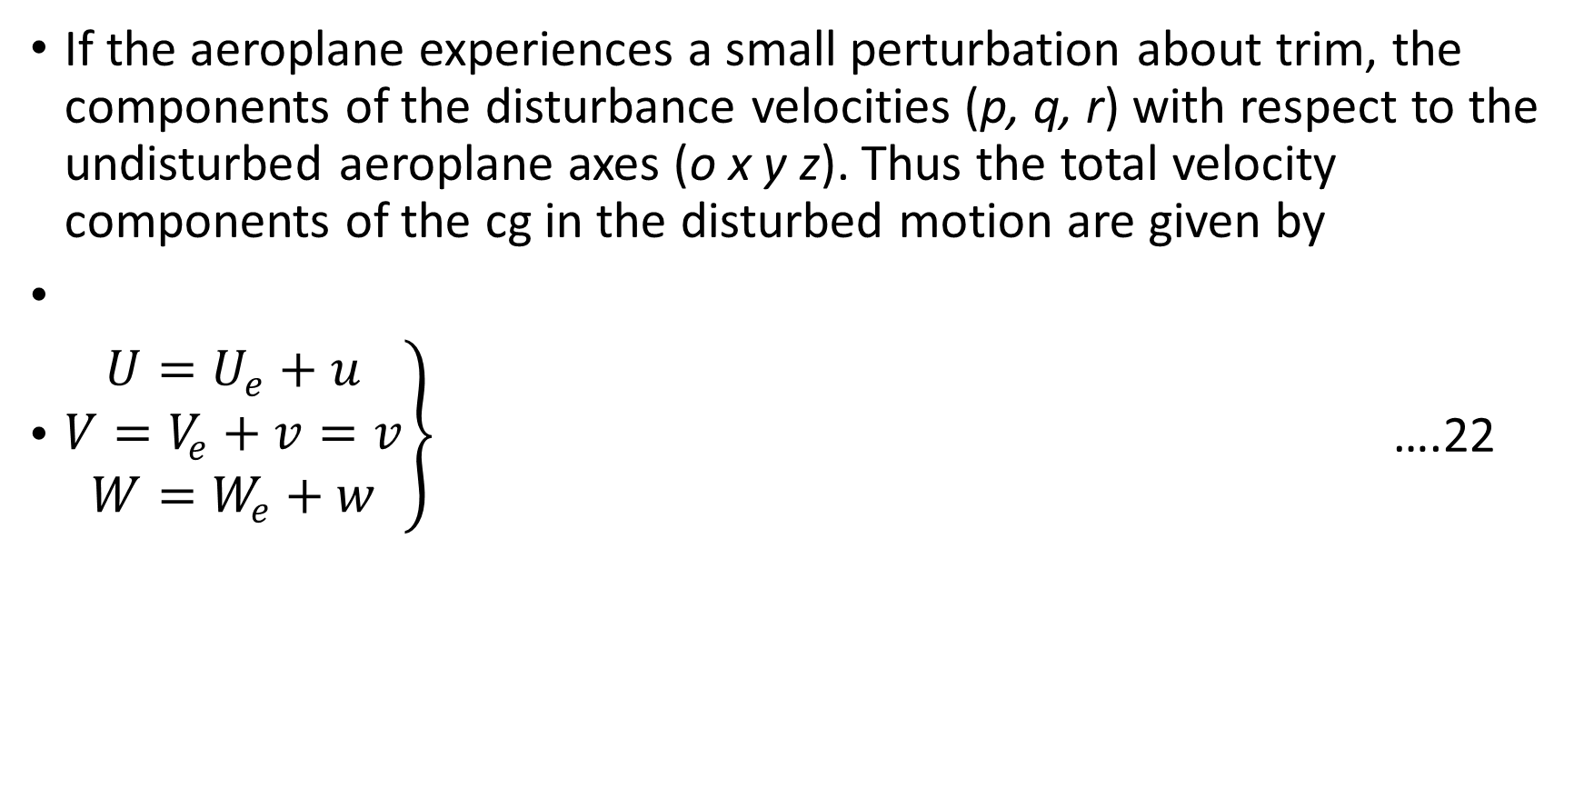
If the aeroplane experiences a small perturbation about trim, the components of the disturbance velocities (p, q, r) with respect to the undisturbed aeroplane axes (o x y z). Thus the total velocity components of the cg in the disturbed motion are given by
$\left.\begin{aligned}U=U_{e}+u \\ V=V_{e}+v=v \\ W=W_{e}+w\end{aligned}\right\}$ ….22

Slide 49
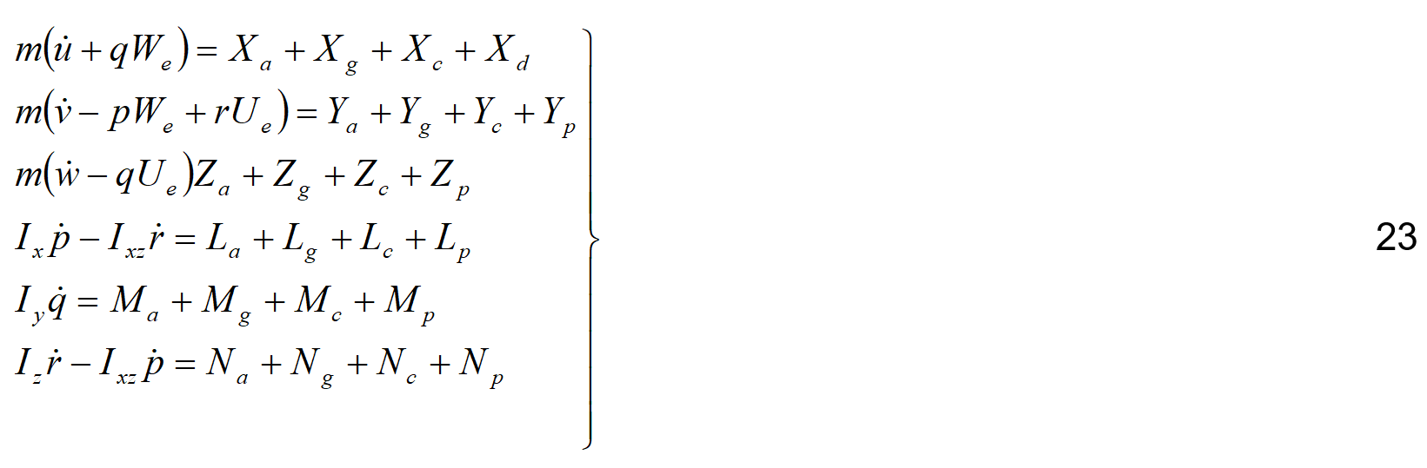
Now by definition (u, v, w) and (p, q, r) are small quantities such that, terms involving products and squares of these terms are insignificantly small terms, the Linearized equations of motion are obtained

Slide 50
The development of expressions to replace the terms on the right-hand side o equations 23 is now much simpler since it is only necessary to consider small disturbances about trim.

Slide 51
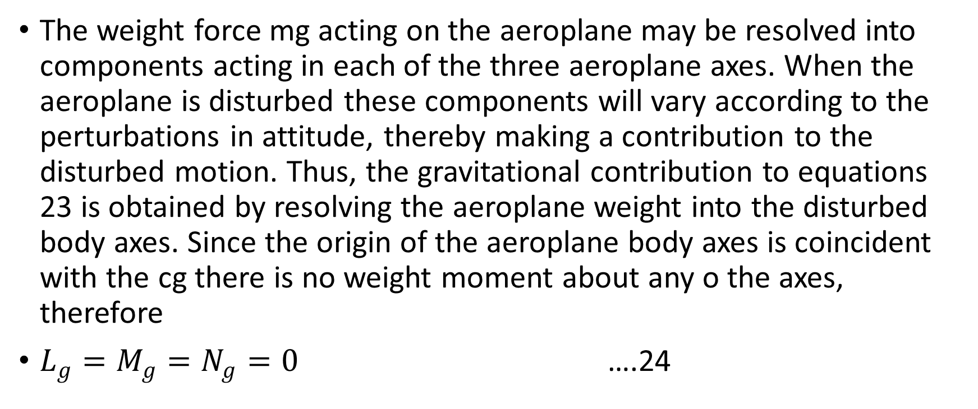
Gravitational Terms
The weight force mg acting on the aeroplane may be resolved into components acting in each of the three aeroplane axes. When the aeroplane is disturbed these components will vary according to the perturbations in attitude, thereby making a contribution to the disturbed motion. Thus, the gravitational contribution to equations 23 is obtained by resolving the aeroplane weight into the disturbed body axes. Since the origin of the aeroplane body axes is coincident with the cg there is no weight moment about any o the axes, therefore
$L_{g}=M_{g}=N_{g}=0$ ….24

Slide 52
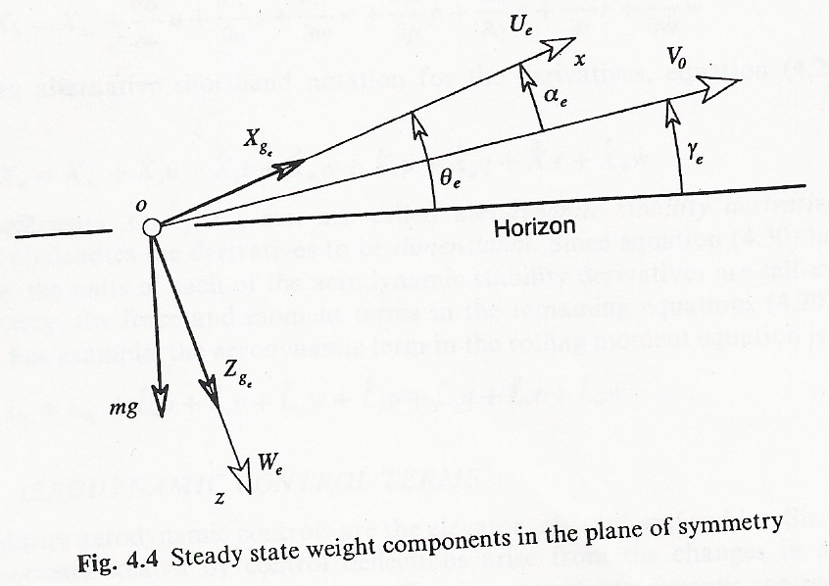
Figure 7: Steady state weight components in the plane of symmetry

Slide 53
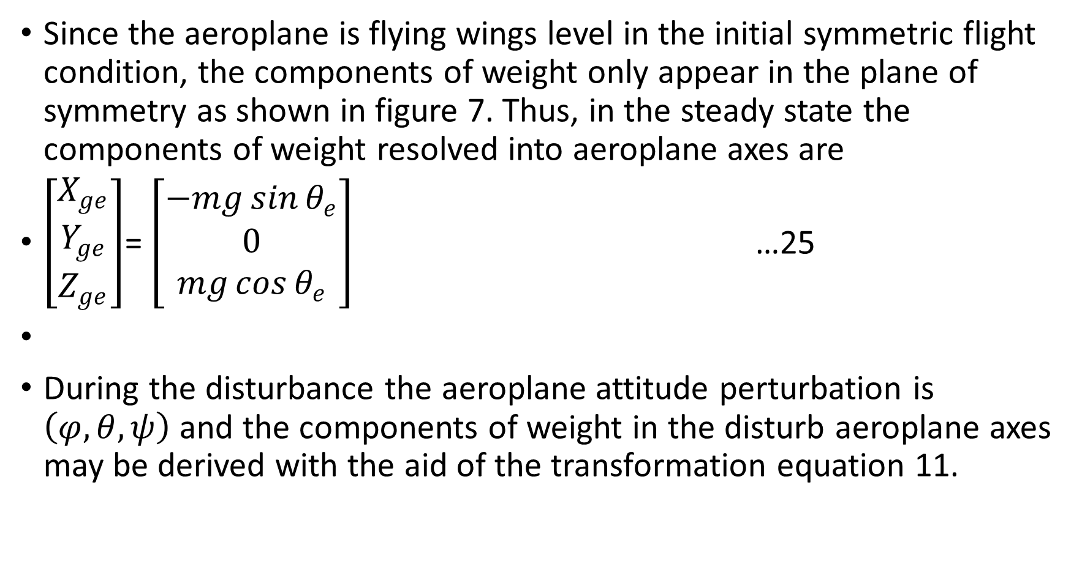
Since the aeroplane is flying wings level in the initial symmetric flight condition, the components of weight only appear in the plane of symmetry as shown in figure 7. Thus, in the steady state the components of weight resolved into aeroplane axes are
$\left[\begin{aligned}X_{ge} \\ Y_{ge} \\ Z_{ge}\end{aligned}\right]$= $\left[\begin{aligned}−mg\sin{θ_{e}} \\ 0 \\ mg\cos{θ_{e}}\end{aligned}\right]$ …25
During the disturbance the aeroplane attitude perturbation is $\left(φ,θ,ψ\right)$ and the components of weight in the disturb aeroplane axes may be derived with the aid of the transformation equation 11.

Slide 54
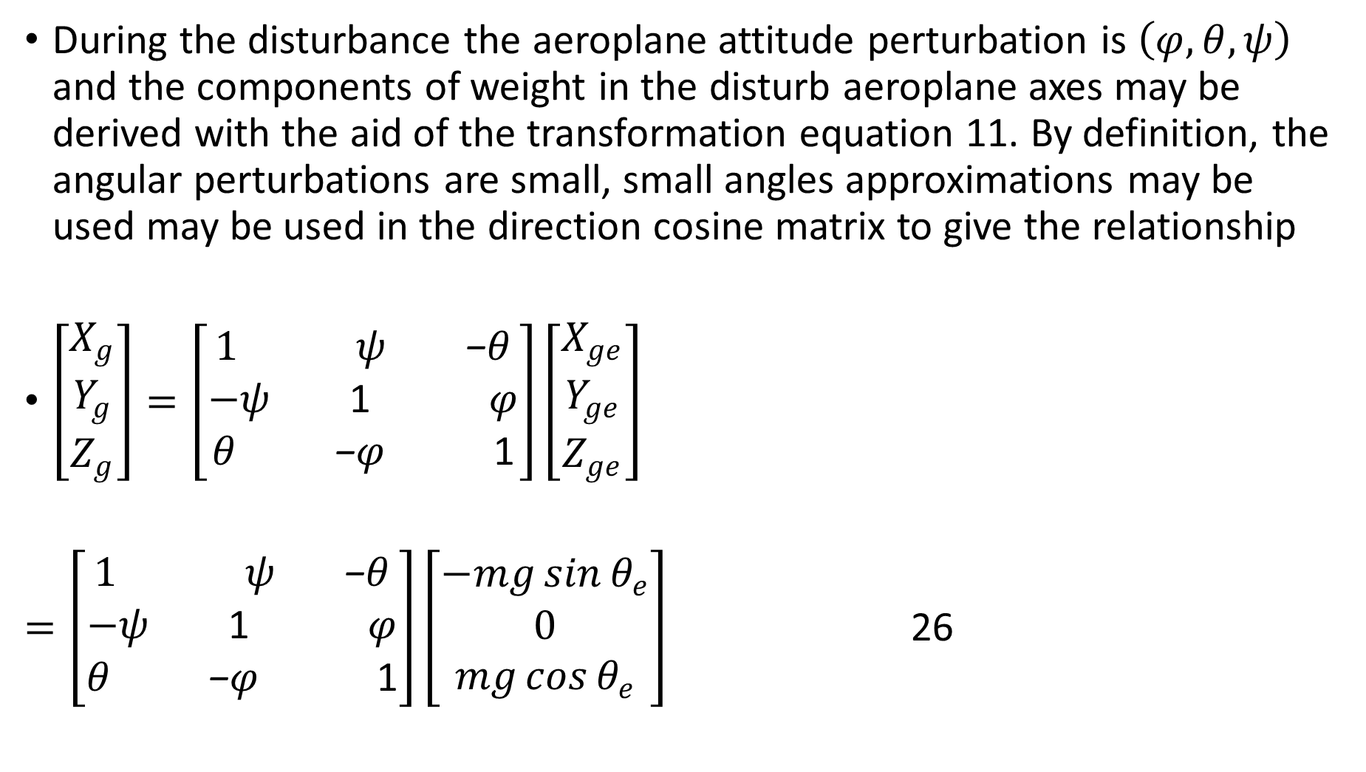
During the disturbance the aeroplane attitude perturbation is $\left(φ,θ,ψ\right)$ and the components of weight in the disturb aeroplane axes may be derived with the aid of the transformation equation 11. By definition, the angular perturbations are small, small angles approximations may be used may be used in the direction cosine matrix to give the relationship
$\left[\begin{aligned}X_{g} \\ Y_{g} \\ Z_{g}\end{aligned}\right]=\left[\begin{aligned}1 ψ \text{−}θ \\ −ψ\text{ 1 }φ \\ θ \text{−}φ\text{ 1}\end{aligned}\right]\left[\begin{aligned}X_{ge} \\ Y_{ge} \\ Z_{ge}\end{aligned}\right]$
$=\left[\begin{aligned}1 ψ \text{−}θ \\ −ψ\text{ 1 }φ \\ θ \text{−}φ\text{ 1}\end{aligned}\right]\left[\begin{aligned}−mg\sin{θ_{e}} \\ 0 \\ mg\cos{θ_{e}}\end{aligned}\right]$ 26

Slide 55
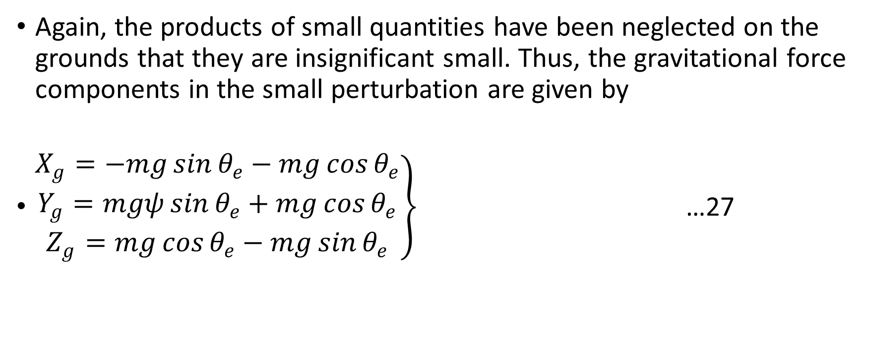
Again, the products of small quantities have been neglected on the grounds that they are insignificant small. Thus, the gravitational force components in the small perturbation are given by
$\left.\begin{aligned}X_{g}=−mg\sin{θ_{e}}−mg\cos{θ_{e}} \\ Y_{g}=mgψ\sin{θ_{e}}+mg\cos{θ_{e}} \\ Z_{g}=mg\cos{θ_{e}}−mg\sin{θ_{e}}\end{aligned}\right\}$ …27

Slide 56
Aerodynamic Terms
Whenever the aerodynamic aeroplane is disturbed from its equilibrium the aerodynamic balance is obviously upset. To describe explicitly the aerodynamic changes occurring during a disturbance provides a considerable challenge in view of the subtle interactions present in the motion.
However, although limited in scope, the method first described by Bryan 1911 works extremely well for classical aeroplane when the motion interest limited to relatively small perturbations. Although, the approach is unchanged the rather more modern notation of Hopkin 1970 is adopted.

Slide 57
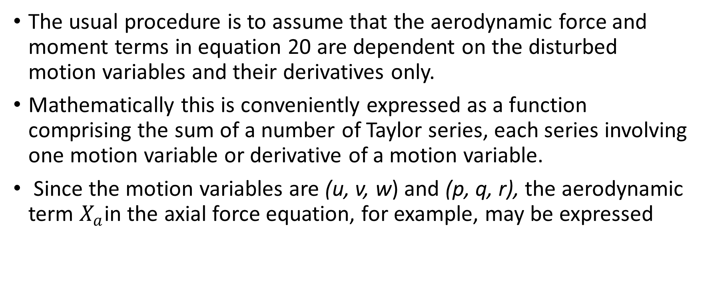
The usual procedure is to assume that the aerodynamic force and moment terms in equation 20 are dependent on the disturbed motion variables and their derivatives only.
Mathematically this is conveniently expressed as a function comprising the sum of a number of Taylor series, each series involving one motion variable or derivative of a motion variable.
Since the motion variables are (u, v, w) and (p, q, r), the aerodynamic term $X_{a}$in the axial force equation, for example, may be expressed

Slide 58
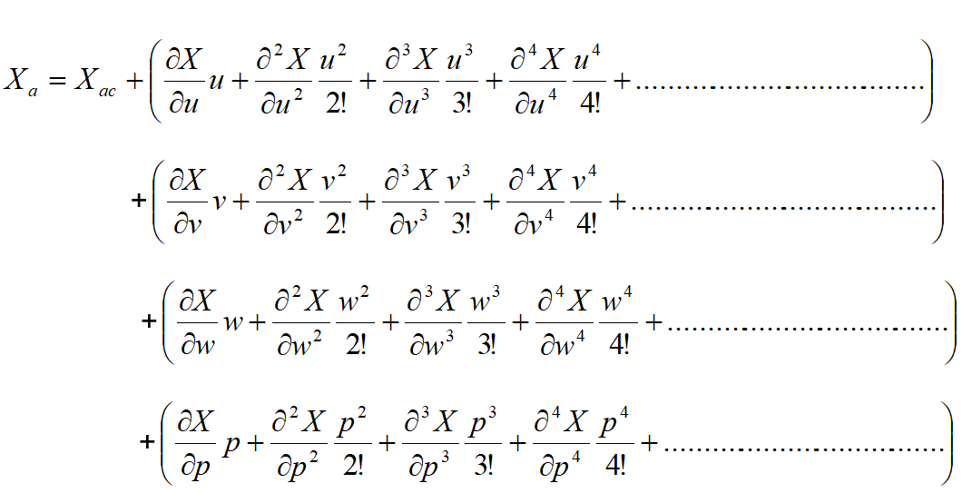

Slide 59
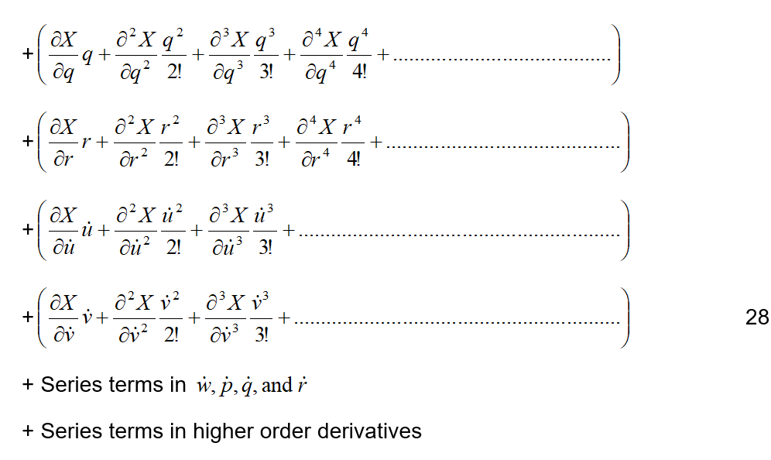

Slide 60
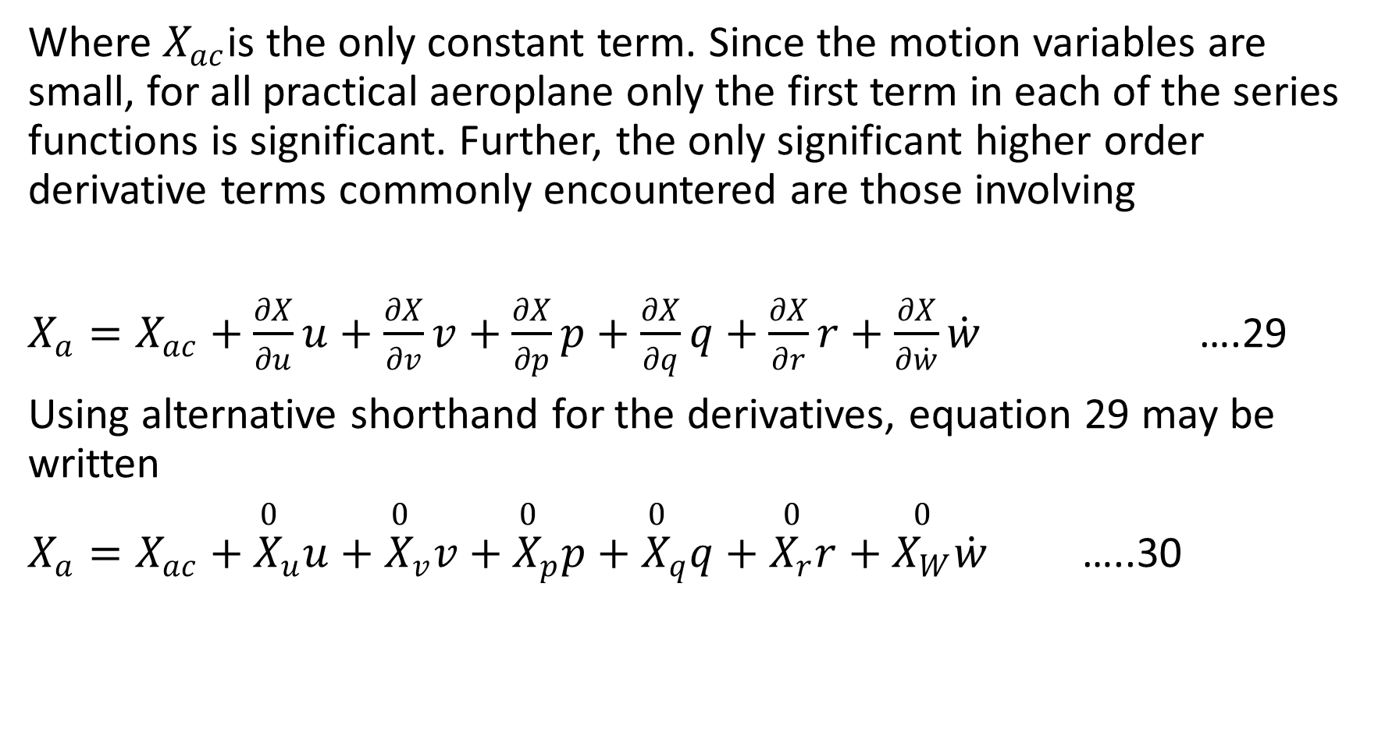
Where $X_{ac}$is the only constant term. Since the motion variables are small, for all practical aeroplane only the first term in each of the series functions is significant. Further, the only significant higher order derivative terms commonly encountered are those involving
$X_{a}=X_{ac}+\frac{∂X}{∂u}u+\frac{∂X}{∂v}v+\frac{∂X}{∂p}p+\frac{∂X}{∂q}q+\frac{∂X}{∂r}r+\frac{∂X}{∂\dot{w}}\dot{w}$ ….29
Using alternative shorthand for the derivatives, equation 29 may be written
$X_{a}=X_{ac}+{\overset{0}{X}}_{u}u+{\overset{0}{X}}_{v}v+{\overset{0}{X}}_{p}p+{\overset{0}{X}}_{q}q+\overset{0}{X_{r}}r+\overset{0}{X_{W}}\dot{w}$ …..30

Slide 61
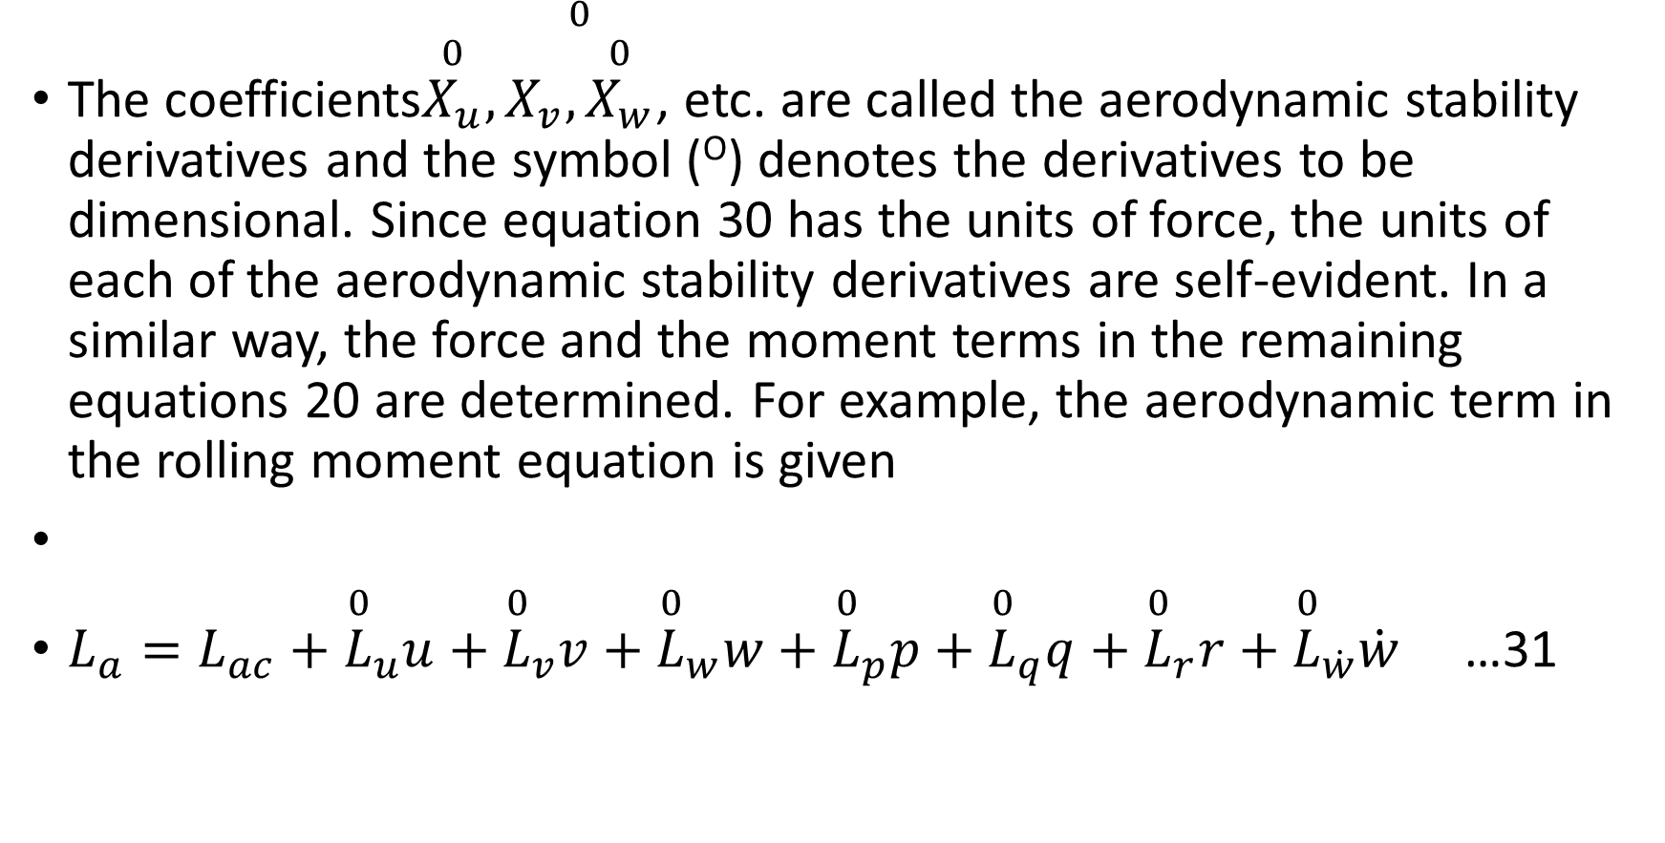
The coefficients$\overset{0}{X_{u}},\overset{0}{X_{v},\overset{0}{X_{w}}}$, etc. are called the aerodynamic stability derivatives and the symbol (^{O}) denotes the derivatives to be dimensional. Since equation 30 has the units of force, the units of each of the aerodynamic stability derivatives are self-evident. In a similar way, the force and the moment terms in the remaining equations 20 are determined. For example, the aerodynamic term in the rolling moment equation is given
$L_{a}=L_{ac}+{\overset{0}{L}}_{u}u+{\overset{0}{L}}_{v}v+{\overset{0}{L}}_{w}w+{\overset{0}{L}}_{p}p+{\overset{0}{L}}_{q}q+{\overset{0}{L}}_{r}r+{\overset{0}{L}}_{\dot{w}}\dot{w}$ …31

Slide 62
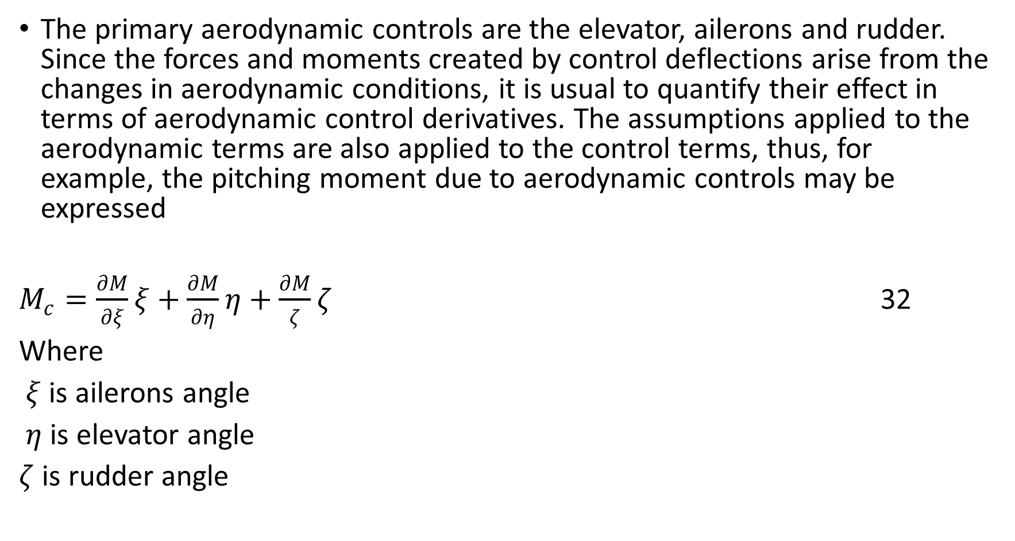
Aerodynamic Control Terms
The primary aerodynamic controls are the elevator, ailerons and rudder. Since the forces and moments created by control deflections arise from the changes in aerodynamic conditions, it is usual to quantify their effect in terms of aerodynamic control derivatives. The assumptions applied to the aerodynamic terms are also applied to the control terms, thus, for example, the pitching moment due to aerodynamic controls may be expressed
$M_{c}=\frac{∂M}{∂ξ}ξ+\frac{∂M}{∂η}η+\frac{∂M}{ζ}ζ$ 32
Where
$ξ$ is ailerons angle
$η$is elevator angle
$ζ$is rudder angle

Slide 63
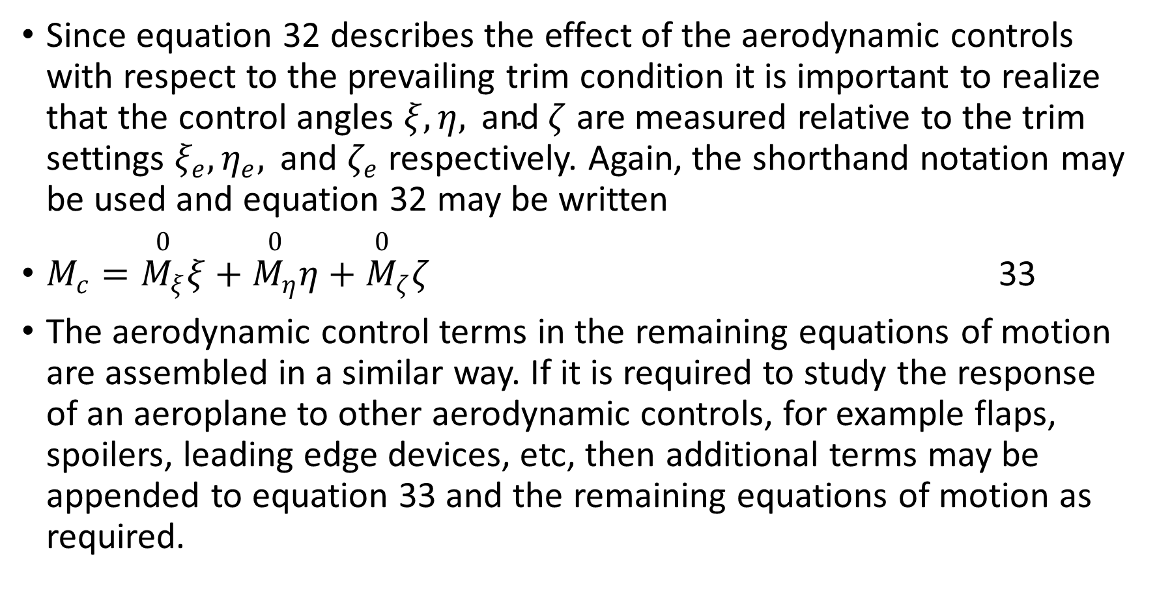
Since equation 32 describes the effect of the aerodynamic controls with respect to the prevailing trim condition it is important to realize that the control angles $ξ,η, \text{and} ζ$ are measured relative to the trim settings $ξ_{e},η_{e}, \text{and} ζ_{e}$ respectively. Again, the shorthand notation may be used and equation 32 may be written
$M_{c}=\overset{0}{M_{ξ}}ξ+\overset{0}{M_{η}}η+{\overset{0}{M}}_{ζ}ζ$ 33
The aerodynamic control terms in the remaining equations of motion are assembled in a similar way. If it is required to study the response of an aeroplane to other aerodynamic controls, for example flaps, spoilers, leading edge devices, etc, then additional terms may be appended to equation 33 and the remaining equations of motion as required.

Slide 64
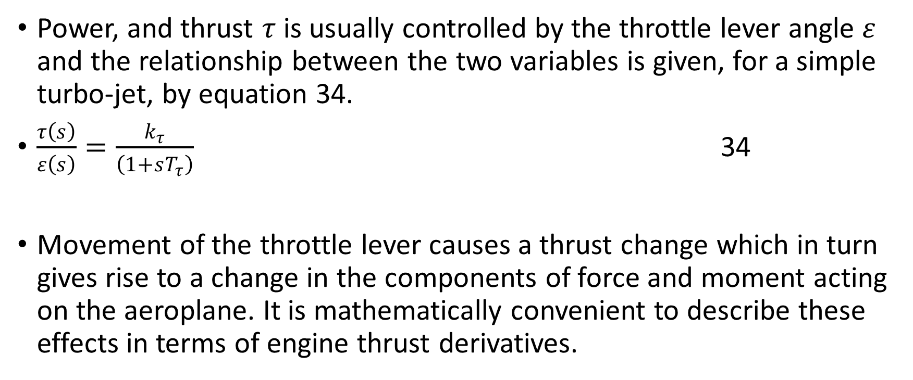
Power Terms
Power, and thrust $τ$is usually controlled by the throttle lever angle $ε$ and the relationship between the two variables is given, for a simple turbo-jet, by equation 34.
$\frac{τ\left(s\right)}{ε\left(s\right)}=\frac{k_{τ}}{\left(1+sT_{τ}\right)}$ 34
Movement of the throttle lever causes a thrust change which in turn gives rise to a change in the components of force and moment acting on the aeroplane. It is mathematically convenient to describe these effects in terms of engine thrust derivatives.

Slide 65

For example, normal force due to thrust may be expressed in the usual shorthand notation
$Z_{p}={\overset{0}{Z}}_{τ}τ$ 35
The contributions to the remaining equations of motion are expressed in a similar way. As for the aerodynamic controls, power changes are measured with respect to the prevailing trim setting. Therefore, $τ$ quantifies the thrust perturbation relative to the trim setting $τ_{e}$.

Slide 66
Equations of motion for small perturbation
To complete the development of the Linearized equations of motion it only remains to substitute the appropriate expressions for the aerodynamic, gravitational, aerodynamic control and thrust terms into equation 23.
The aerodynamic terms are exemplified by expressions like 30 and 31, expressions for the gravitational terms are given in equations 27, the aerodynamic control terms are exemplified by expressions like equation 33 and the thrust terms are exemplified by expressions like equation 34. Bringing all of these together the following equations are obtained

Slide 67


Slide 68


Slide 69

Now in the steady trimmed flight condition all the perturbation variables are their derivatives are, by definition, zero. Thus in the steady state equation 35 reduce to derivatives are, by definition, zero. Thus in the steady state equations 35 reduce to
Equation 36 therefore identify the constant trim terms which may be substituted into equations 35 and, following rearrangement, they may be written

Slide 70


Slide 71
Equations 37 are the small perturbation equations of motion, referred to body axes, which describe the transient response of an aeroplane about the trimmed flight condition following a small input disturbance. The equations comprise a set of six simultaneous linear differential equations written in the traditional manner with the forcing, or input terms on the right-hand side.
As written, and subject to the assumptions made in their derivation, the equations of motion are perfectly general and describe motion in which longitudinal and lateral dynamics may be fully coupled. However, for the vast majority of aircrafts when small perturbation transient motion is considered, as is the case here, longitudinal- lateral coupling is usually negligible.
Consequently, it is convenient to simplify the equations by assuming that longitudinal and lateral motion is in fact, fully decoupled.

Slide 72

Longitudinal equations of motion
Decoupled longitudinal motion is motion in response to a disturbance that is constrained to the longitudinal plane of symmetry, the oxy plane, only. The motion is therefore described by the axial force X, the normal force Z and the pitching moment M equations only.
Since no lateral motion is involved the lateral motion variables $v,p \text{and} r$and their derivatives are all zero. Also, decoupled longitudinal-lateral motion means that the aerodynamic coupling derivatives are all zero. Also, decoupled longitudinal-lateral motion means that the aerodynamic coupling derivatives are negligible small and may be taken as zero, hence
$\overset{o}{X_{v}}=\overset{o}{X_{p}}=\overset{o}{X_{r}}=\overset{o}{Z_{v}}=\overset{o}{Z_{p}}=\overset{o}{Z_{r}}=\overset{o}{M_{v}}=\overset{o}{M_{p}}=\overset{o}{M_{r}}=0$

Slide 73

Similarly, since the aileron or rudder deflections do not usually cause motion in the longitudinal plane of symmetry the coupling aerodynamic control derivatives may also be taken as zero, thus
$\overset{o}{X_{ξ}}=\overset{o}{X_{ζ}}=\overset{o}{Z_{ξ}}=\overset{o}{Z_{ζ}}=\overset{o}{M_{ξ}}=\overset{o}{M_{ζ}}=0$ 39
The longitudinal symmetric motion are therefore obtained by extracting the axial force, normal force and pitching moment equations from 37 and substituting equations 38 and 39 as appropriate.

Slide 74

Hence
$\left.\begin{aligned}m\dot{u}−\overset{o}{X_{u}}u−\overset{o}{X_{\dot{w}}}\dot{w}−\overset{o}{X_{w}}w−\left(\overset{o}{X_{q}}q−mW_{e}\right)q+mgθ\cos{θ_{e}}=\overset{o}{X_{η}}η+\overset{o}{X_{τ}}τ \\ −\overset{o}{Z_{u}}u+\left(m−\overset{o}{Z_{\dot{w}}}\right)\dot{w}−\overset{o}{Z_{w}}w−\left(\overset{o}{Z_{q}+mU_{e}}\right)q=\overset{o}{Z_{η}}η+\overset{o}{Z_{τ}}τ \\ −\overset{o}{M_{u}}u−\overset{o}{M_{\dot{w}}}\dot{w}−\overset{o}{M_{w}}w+I_{y}\dot{q}−{\overset{o}{M}}_{q}q=\overset{o}{M_{η}}η+\overset{o}{M_{τ}}τ\end{aligned}\right\}$…40
Equations 40 are the most general form of the dimensional decoupled equations of longitudinal symmetric motion referred to aeroplane body axes.

Slide 75

I f it is assumed that the aeroplane is level flight and the reference axes are wind or stability axes then
$θ_{e}=W_{e}=0$ 41
And the equations simplify further to
$\left.\begin{aligned}m\dot{u}−\overset{o}{X_{u}}u−\overset{o}{X_{\dot{w}}}\dot{w}−\overset{o}{X_{w}}w−\overset{o}{X_{q}}q+mgθ=\overset{o}{X_{η}}η+\overset{o}{X_{τ}}τ \\ −\overset{o}{Z_{u}}u+\left(m−\overset{o}{Z_{\dot{w}}}\right)\dot{w}−\overset{o}{Z_{w}}w−\left(\overset{o}{Z_{q}+mU_{e}}\right)q=\overset{o}{Z_{η}}η+\overset{o}{Z_{τ}}τ \\ −\overset{o}{M_{u}}u−\overset{o}{M_{\dot{w}}}\dot{w}−\overset{o}{M_{w}}w+I_{y}\dot{q}−{\overset{o}{M}}_{q}q=\overset{o}{M_{η}}η+\overset{o}{M_{τ}}τ\end{aligned}\right\}…$42
Equations 42 represent the simplest possible form of the decoupled longitudinal equations of motion. Further simplification is only generally possible when the numerical values of the coefficients in the equations are known since some coefficients are often negligibly small.

Slide 76

Lateral-directional equations of motion
Decoupled lateral-directional motion involves roll, yaw and sideslip only. The motion is therefore described by the side force Y, the rolling moment and the yawing moment N equations only. Since no longitudinal motion is involved, the longitudinal motion variables u, w, q and their derivatives are all zero.
Also, decoupled longitudinal lateral motion means that the aerodynamic derivatives are negligibly small and may be taken as zero, hence
$\overset{o}{Y_{u}}=\overset{o}{Y_{\dot{w}}}=\overset{o}{Y_{w}}=\overset{o}{Y_{q}}=\overset{o}{L_{u}}=\overset{o}{L_{\dot{w}}}=\overset{o}{L_{w}}=\overset{o}{L_{q}}=\overset{o}{N_{u}}=\overset{o}{N_{\dot{w}}}=\overset{o}{N_{w}}=\overset{o}{N_{q}}=0$
…43

Slide 77

Similarly, since the airframe is symmetric, elevator deflection and thrust variation do not usually cause lateral-directional motion and the coupling aerodynamic control derivatives may also be taken as zero, thus
$\overset{o}{Y_{η}}=\overset{o}{Y_{τ}}=\overset{o}{L_{η}}=\overset{o}{L_{τ}}=\overset{o}{N_{η}}=\overset{o}{N_{τ}}=0$ 44
The equations of lateral asymmetric motion are therefore obtained by extracting the side force, rolling moment and yawing moment equations 37 and substituting equations 43 and 44 as appropriate.

Slide 78

Hence
$$\left.\begin{aligned}\left(m\dot{v}−\overset{o}{Y_{v}}v−\left(\overset{o}{Y_{p}+mW_{e}}\right)p−\left({\overset{o}{Y}}_{r}−mU_{e}\right)r−mgφ\cos{θ_{e}}−mgψ\sin{θ_{e}}\right)=\overset{o}{Y_{ξ}}ξ+\overset{o}{Y_{ζ}}ζ \\ −\overset{o}{L_{v}v}+I_{x}\dot{p}−\overset{o}{L_{p}p}−I_{xz}\dot{r}−\overset{o}{L_{r}}r=\overset{o}{L_{ξ}}ξ+\overset{o}{L_{ζ}}ζ \\ −\overset{o}{N_{v}v}+I_{xz}\dot{p}−\overset{o}{N_{p}p}+I_{z}\dot{r}−\overset{o}{N_{r}}r=\overset{o}{N_{ξ}}ξ+\overset{o}{N_{ζ}}ζ\end{aligned}\right\}$$
….45
Equations 45 are the most general form of the dimensional decoupled equations of lateral-directional asymmetric motion referred to aeroplane body axes.

Slide 79

If it is assumed that the aeroplane is in level flight and the reference axes are wind or stability axes then, as before,
$θ_{e}=W_{e}=0$
And the equations simplify further to
$\left.\begin{aligned}m\dot{v}−\overset{o}{Y_{v}}v−p\overset{o}{Y_{p}}−\left(\overset{o}{Y_{r}}−mU_{e}\right)r−mgφ=\overset{o}{Y_{ξ}}ξ+\overset{o}{Y_{ζ}}ζ \\ −\overset{o}{L_{v}v}+I_{x}\dot{p}−\overset{o}{L_{p}p}−I_{xz}\dot{r}−\overset{o}{L_{r}}r=\overset{o}{L_{ξ}}ξ+\overset{o}{L_{ζ}}ζ \\ −\overset{o}{N_{v}v}+I_{xz}\dot{p}−\overset{o}{N_{p}p}+I_{z}\dot{r}−\overset{o}{N_{r}}r=\overset{o}{N_{ξ}}ξ+\overset{o}{N_{ζ}}ζ\end{aligned}\right\}$ …47
Equations 42 represent the simplest possible form of the decoupled lateral-directional equations of motion.
. As for the longitudinal equations of motion, further simplification is only generally possible when the numerical values of the coefficients in the equations are known since some coefficients are often negligibly small.

